Slide 1

^{簡介}系統工程
台大生物機電工程系 方煒

Slide 2
生機系的領域
生命科學與工程的整合
Engineering
Bring engineering to life
Bring life to engineering
Life

Slide 3
生物機電
Bio-mechatronics
向大自然學習
Learn from the Nature
觸類旁通
異中求同

Slide 4
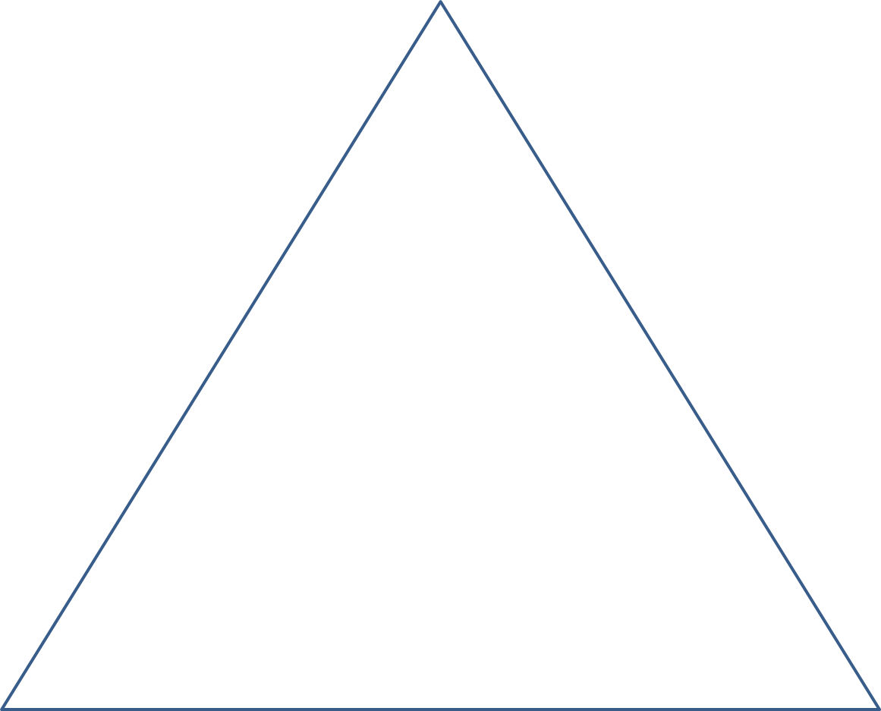
課程定位
領導
Leadership
Integration 整合
Systems Engineering
foundations 基礎
工程、生物、管理、財務、會計、金融、
市場、行銷、推廣、傳播

Slide 5
E. vs. S.E.

Slide 6
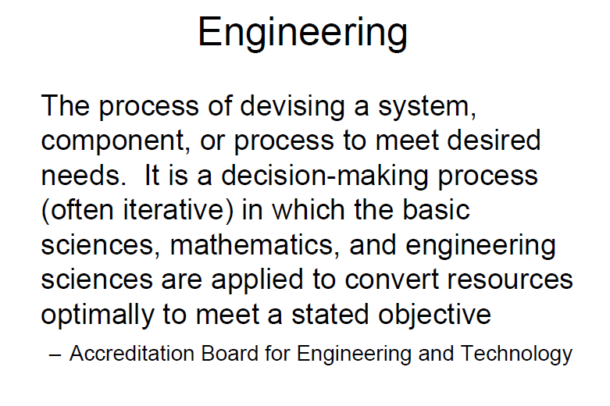

Slide 7
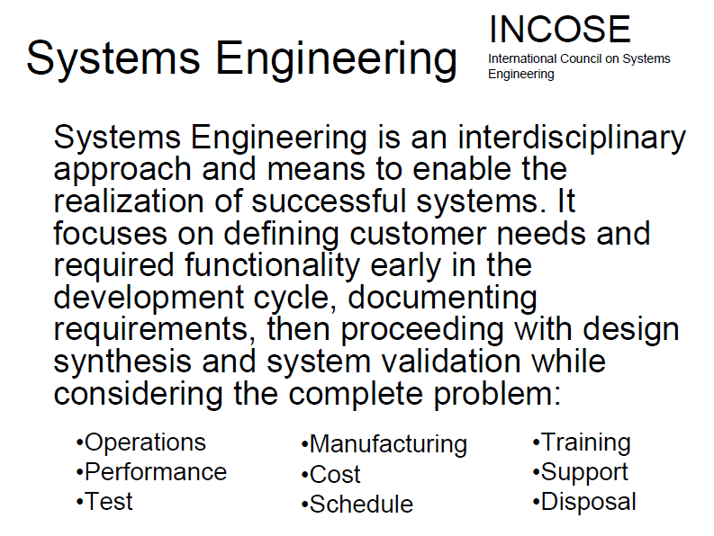

Slide 8
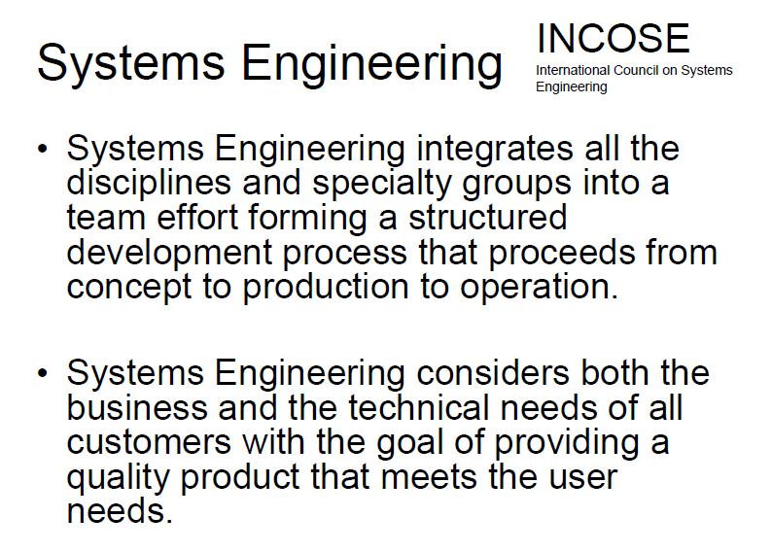

Slide 9
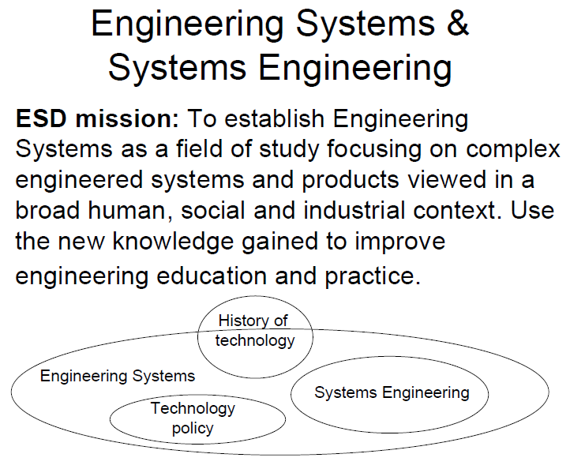

Slide 10
Engineering systems in Biology
Engineering Bio-systems
環控農業 Controlled Environment Agriculture
  植物工廠 Plant Factory
    Thermally insulated wall / roof / floor
    Artificial light
    Multi-layer bench
    Water/Nutrient recirculating
    Aero & Root Environmental control
    Automation

Slide 11
Engineering Bio-systems
環控農業 Controlled Environment Agriculture
  複合式植物工廠
    氮源共享：魚菜共生 Aquaponics
    碳源共享：菇類栽培廠 + 植物工廠
    能源共享：農產品冷藏庫 + 植物工廠

Slide 12
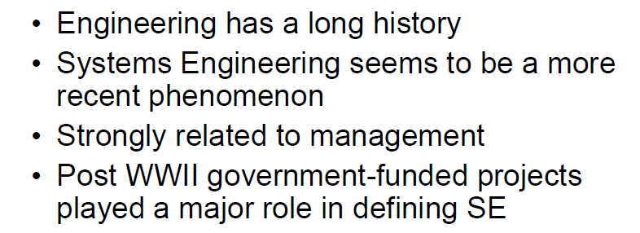

Slide 13
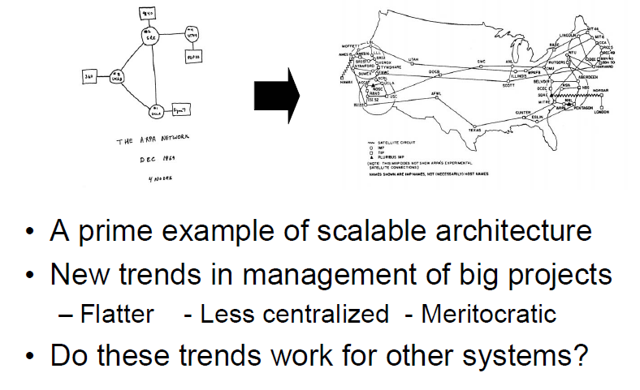
System Engineering implemented: ARPANET

Slide 14
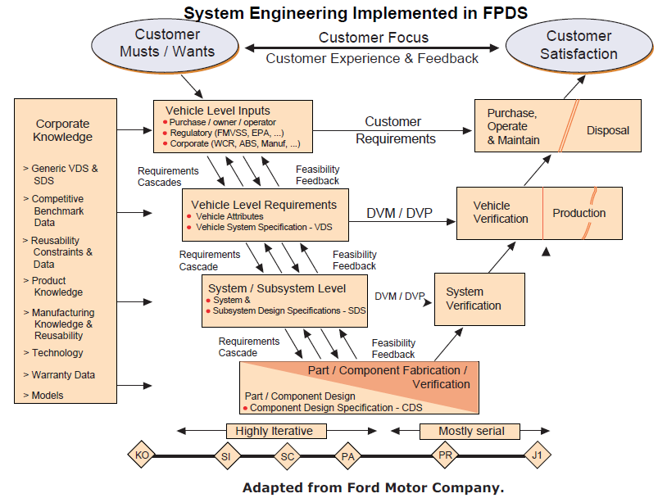

Slide 15
History of Bio-systems Engineering
農業的演進
  露天農業 Open field Agriculture
  半封閉式農業 Semi-closed Agriculture
    設施農業：網室、溫室
  封閉式農業 Closed Agriculture
    植物工廠
NASA: 太空農業計畫 1990 ~ 2000
  ALSS: 先進__生命支援系統
  BLSS：可生質再生＿生命支援系統
  CELSS：生態控制＿生命支援系統
Vertical Farming / Plant Factory 1999 ~
CEA

Slide 16
NASA太空農業計畫
  系統內的生產者、消費者、分解者必需時時維持平衡
ALSS: Advanced Life Support System
BLSS: Bio-regenerative Life SS
CELSS: Controlled Ecological Life SS
  植物變成工程元件
  可生產多少 Biomass 與 氧氣
  可吸收多少二氧化碳，
  分解多少廢棄物，都需要量化

Slide 17
A Schematic ALSS
Crew
Space
Plant
Growth
Unit
De-
humidifier
Air
Purifier
Water
Purifier
Food
Processing
Unit
Waste
Processing
Unit
Air
Water
(After M.M. Averner, 1989)
Biomass

Slide 18
CEA 環控農業
Controlled Environment Ag/Aq/Ap
  Ag: Agriculture
    CEPPS: Plant Production System 環控作物量產系統
    CEAPS: Animal Production System 環控動物量產系統
  Aq: Aquaculture 循環水養殖
  Ap: Aquaponic 複合養殖

Slide 19
Controlled Ecological Ag/Aq/Ap
生態控制下的廣義農業/養殖漁業/複合養殖
何謂生態控制?
  系統內的生產者、消費者、分解者
  能時時維持平衡
  允許穩態量產

Slide 20
何謂 穩態量產 ?
循環水養蝦、養藻與養牡蠣
如何確保能夠穩態量產
  假設生產期程需要 16 週
  生產系統便需要 16 套
  每週供應固定數量的飼料
  每週收穫固定數量的產品

Slide 21
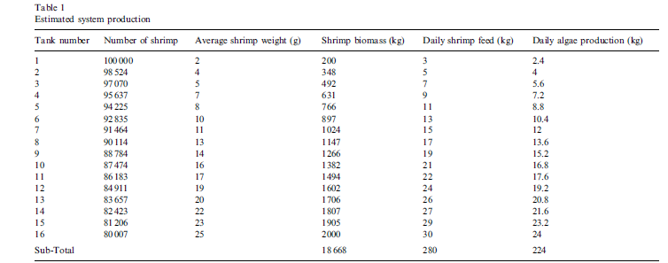
a microalgae-based recirculating oyster and shrimp system
每天隨時有 18668 kg 的蝦子在養數量
每週可收穫 2000 kg 的蝦子
每天餵飼 280 kg 的飼料
每天產出 224 kg 的藻類
每天產出 112 kg 的牡蠣肉，相當於 700 kg 的牡蠣

Slide 22
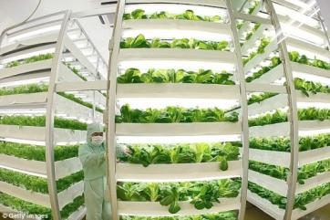
何謂 穩態量產 ?
立體化短期葉菜類栽培
35天生長期
育苗 14 天，育成 21 天
  3套系統 → 每週收穫
  21套系統 → 每天收穫
育苗 21 天，育成 14 天
  2套系統 → 每週收穫
  14套系統 → 每天收穫
一年收穫 18 次
一年收穫 26 次

Slide 23
Qualitative / Quantitative Evaluation of Performance

Slide 24
Evaluation of Performance
Qualitative is OK but not accepted for engineering tasks
Quantitative is better
  KPI such as COP, EER, VER, RUE, ..

Slide 25
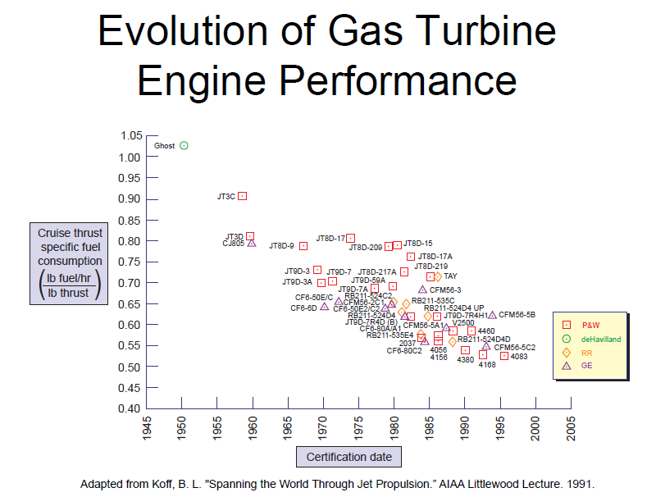
一覽無遺
科技的進展
個人/公司/國家的競爭力
技術的現況

Slide 26
Evaluation of performance of artificial lights
Lighting efficiency：lm/W 每瓦產生的流明
照度：
  lm/ft² : candle 燭光
  lm/m²: lux 勒克斯
照度以人眼對光譜的敏感度為基準
人眼與植物葉綠體對光譜的敏感度有很大差異
照度單位不適用於植物照明

Slide 27
多種植物照明用人工光源的發光效率
Comp_Spec of Light sources | Reflectors on top | No. of tubes or panels | PPF* μmol m⁻² s⁻¹ | PPF x Area ( μmol s⁻¹ ) | Power consumption, W | Efficiency, μmol J⁻¹
S_CW1.8 | Y | 6 Tubes | 334.9 ± 86.6 | 723.4 | 172.97 | 4.2
T_V | Y | 9 tubes | 281.6 ± 59.4 | 608.4 | 195 | 3.1
H_CW | Y | 9 tubes | 273.9 ± 79.8 | 73.9 | 212 | 3.1
T_A | Y | 9 tubes | 225.8 ± 49.1 | 487.8 | 189 | 2.6
E_CW | Y | 9 tubes | 263.8 ± 64.2 | 569.8 | 228 | 2.5
T_A | no need | 12 panels | 411.5 ± 103.2 | 888.9 | 432 | 2.1
T_N | Y | 9 tubes | 186.7 ± 39.3 | 403.2 | 196 | 2.1
E_WW | Y | 9 tubes | 210.8 ± 51.0 | 455.3 | 229 | 2.0
T_N | no need | 12 panels | 378.4 ± 95.4 | 809.6 | 428 | 1.9
T_M | Y | 9 tubes | 168.0 ± 39.1 | 326.9 | 193 | 1.9
T_M | no need | 12 panels | 387.3 ± 99.4 | 836.5 | 442 | 1.9
T_Y | Y | 9 tubes | 168.3 ± 34.7 | 363.5 | 188 | 1.9
S_R | no need | 12 panels | 291.0 ± 71.3 | 628.6 | 334 | 1.9
T5FL_CW | Y | 9 tubes | 250.0 ± 57.5 | 540 | 283 | 1.9
* Measured at 10 cm distance under light except the T5FL treatment (at 20 cm distance)
** Area of culture Bed on bench per layer = 1.8 m x 1.2 m = 2.16 m²

Slide 28
Profit from production
Profit = Revenue – Cost
What’s missing?
  Time involved
  Space occupied
  Cost breakdown into details
    Depreciation counted?
A better KPI in plant production:
$/(week*m²)

Slide 29
An example on
‘parallel installation of compressors’
仿生 Bio-mimicry

Slide 30
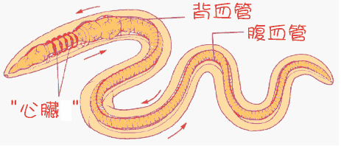

Slide 31
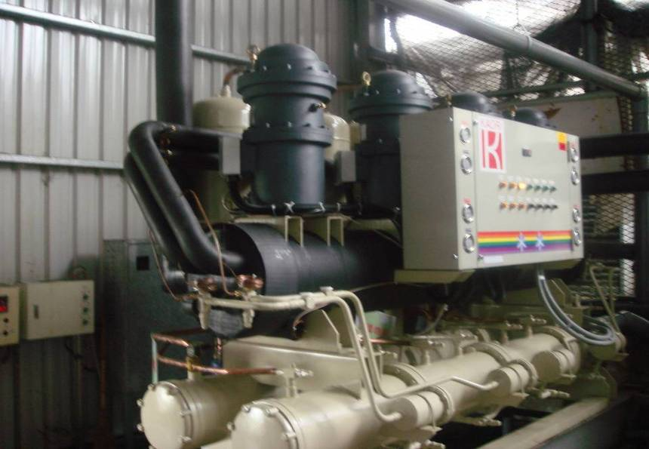
多台壓縮機並聯

Slide 32
An example on
‘parallel distribution of pipes’
仿生 Bio-mimicry

Slide 33
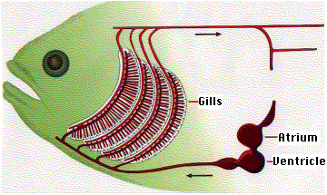
心房
心室

Slide 34
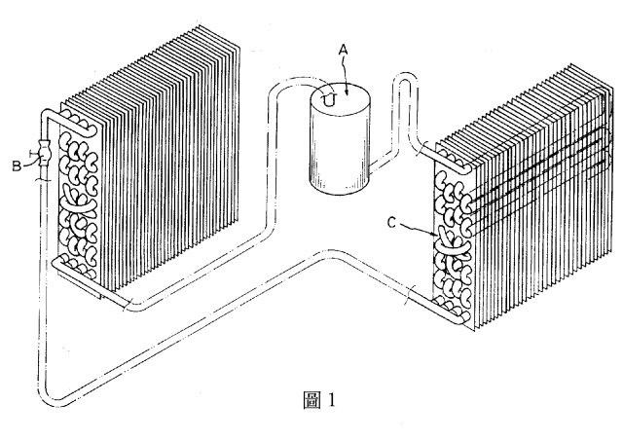
冷媒流向：分流，對調與合流
C
冷排
熱排
均勻吸熱
均勻散熱

Slide 35
An example on
‘3 head pipes for even distribution’
仿生 Bio-mimicry

Slide 36
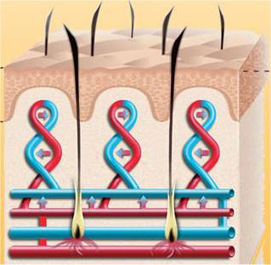
血管：如何均勻輸送
3 head pipes

Slide 37
傳統 地底加熱系統1

Slide 38
傳統 地底加熱系統2

Slide 39
修正的 地底加熱系統

Slide 40
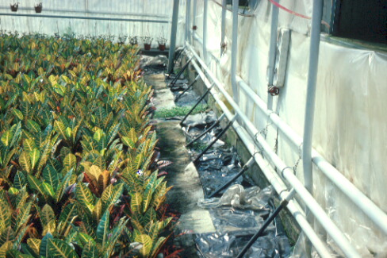
修正的溫室地底加熱系統
3 head pipes

Slide 41
A biomimicry example on
‘oxygen/heat exchange’
仿生 Bio-mimicry

Slide 42
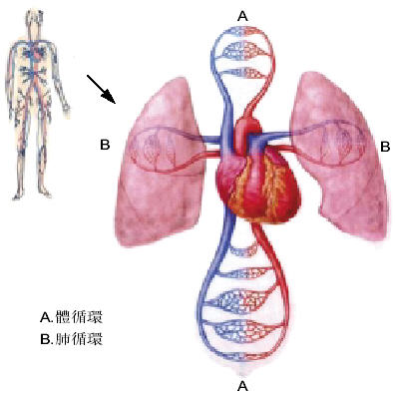

Slide 43
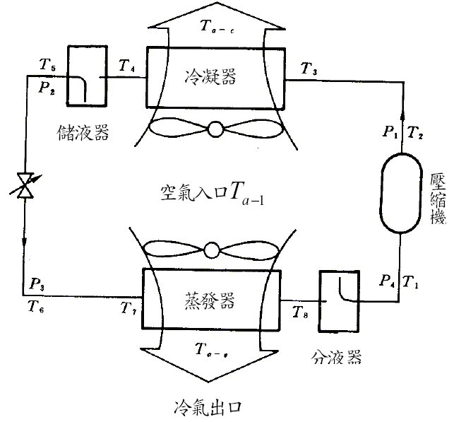
傳統 冷凍空調系統
熱氣出口

Slide 44
血液循環 | 冷凍空調
血管缺乏舒張壓就没有彈性位能，血管與器官都會扁掉 | 冷媒管缺乏低壓側壓力，大氣壓力與壓縮機的負壓會把冷媒管壓扁
收縮壓 (血液擠向動脈) 動態調配血液的力量 | 高壓側壓力
舒張压 (血液由動脈流出) 保持血管彈性的力量 | 低壓側壓力 讓冷媒流回壓縮機的力量
體循環供給身體氧氣 | 高壓側散熱
肺循環交換取得氧氣 | 低壓側吸熱

Slide 45
右心房
Modified 冷凍空調系統
右心室
熱氣出口
三尖瓣
動脈
靜脈
身體
右肺動脈
左心房
左肺動脈
二尖瓣
肺臟
左心室

Slide 46
A biomimicry example on
‘accumulator vessel’

Slide 47
心房
心室

Slide 48
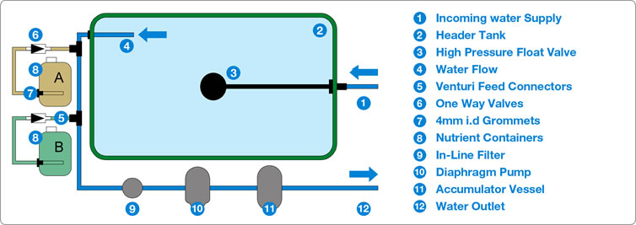

Slide 49
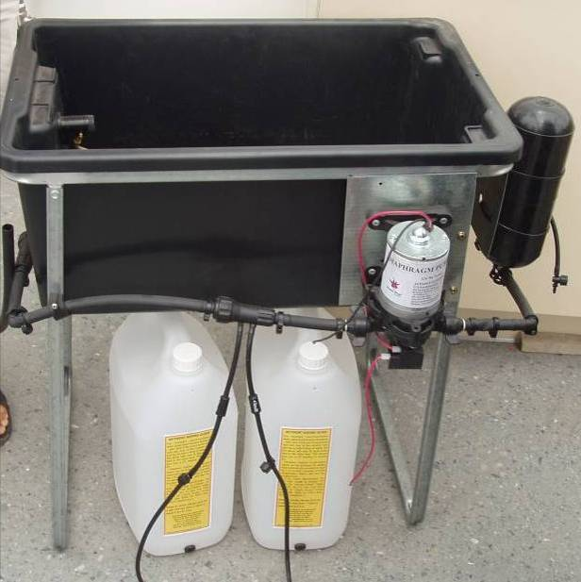

Slide 50
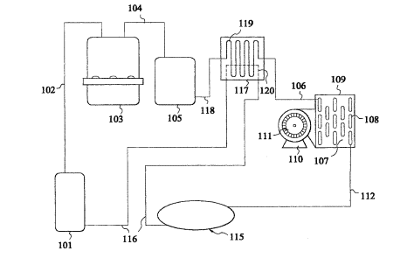
Modified 冷凍空調系統
熱回收裝置
壓縮機
Accumulator
冷凝器/熱排
蒸發器/冷排
膨脹閥

Slide 51
更多範例
觸類旁通、異中求同
太極理念應用於冷凍空調系統之研發

Slide 52
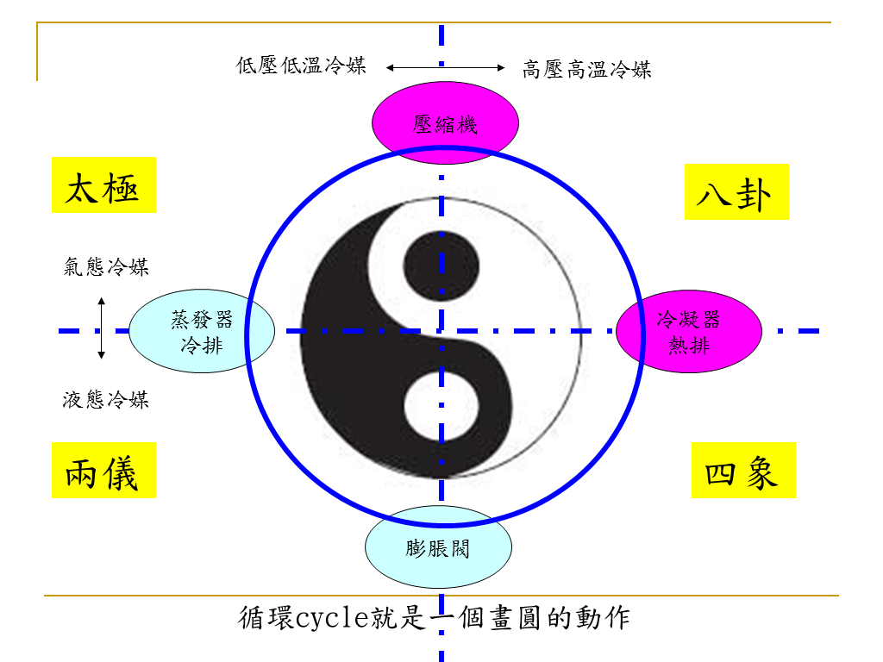

Slide 53
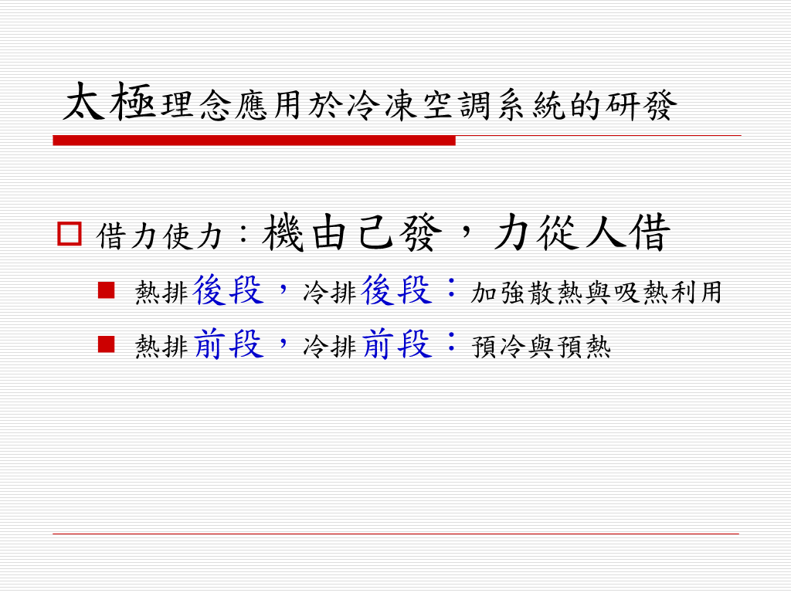

Slide 54
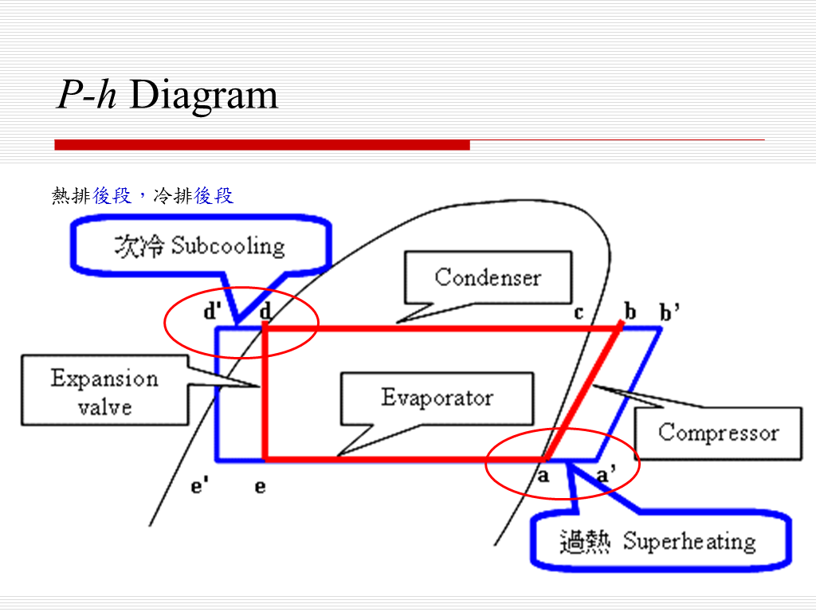

Slide 55
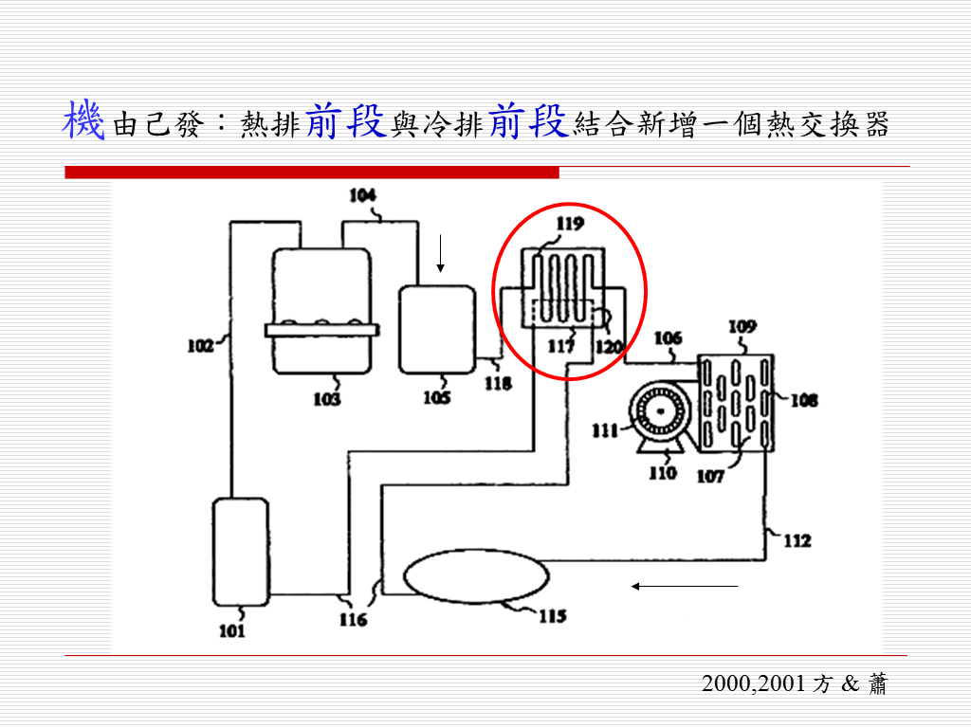

Slide 56
更多範例
觸類旁通、異中求同
發散式思考

Slide 57
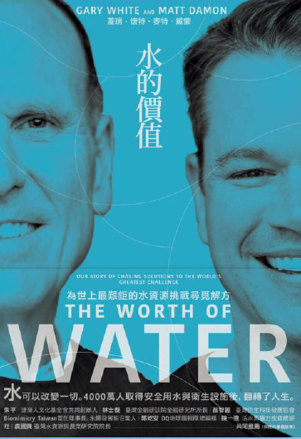
水
水的價值
物以稀為貴
利之所趨
關鍵的就會成為趨勢
參與者眾，就會形成產業

Slide 58
水產業
提供潔淨的淡水：水處理
提供美容、醫療功能的水：機能水
提供滅菌功能的水：電解水
提供量化指標：檢測儀器、感測器
物理法、化學法、生物法
物化法、生化法、生物物理法

Slide 59
光
人工照明 --> 需求引導趨勢

Slide 60
LED 應用於生物產業
美容醫療：
  柔光回春
  免疫提升
  光動力療法
照明：路燈、車燈、室內照明
植物照明：光質、光量、光週
經濟動物催情、肌肉增生
昆蟲誘捕、水下魚蝦誘引
檢測儀器

Slide 61
更多範例
吾道一以貫之
相通技術應用於不同對象
範例：
  環控農業
    環控：地上環境、地下環境 (水下)
    農業：廣義定義包含農漁牧

Slide 62
甚麼是 Phytomation ?
由設施農業 (Protected cultivation)
發展到環控作物生產系統 (Controlled Environment Plant Production Systems )
再下一步的進階就是Phytomation

Slide 63
From Protected Cultivation
to Controlled Environment Plant Production Systems
to Phytomation
Phytomation
* Protected cultivation
** Controlled Environment
Plant Production Systems
ACESys
Environment
Friendliness
NJ-NSCORT
for ALSS
Applied
Intelligence
Growing
Systems
Phyto-
remediation
Operations
Research
Production
Environment*
CEPPS**
Greenhouse
Structures

Slide 64
A
E
E
Sys
C
E
Plant Quality

Slide 65
Automation-Culture-Environment-Systems (ACESys) Oriented Approach to Phytomation
AUTOMATION: Machine Capabilities of Perception; Reasoning & Learning; Communication; and Task Planning & Execution
Automation and Culture
Automation and Environment
SYSTEMS: Studies, Analysis, and Integration for overall Technical Workability, Economic Viability, Energy Efficiency, Ecological Harmony, Social & Political Issues, Optimization, and Management
ENVIRONMENT: The Surroundings and processes including Air, Water, Soil, and controlled environment
CULTURE: Biology and Cultural Practices of crops
Culture and Environment

Slide 66
Concept of
Automation-Culture-Environment Oriented Systems Analysis (ACESYS)
Components and Processes of Controlled Environment Bio-Production Systems may be categorized into three classes: (K.C. Ting, 1994)
Automation – machine capabilities of information processing and physical work (including perception, reasoning/learning, communication, and task planning/execution)
Culture – factors and practices that can directly describe and/or modify the growth and development of biological objects (e.g. morphological and physiological conditions, as well as cultural tasks including multiplication, nutrient delivery, disease prevention, harvesting, etc.)
Environment – surroundings of biological objects (including climatic, nutritional, structural, and mechanical conditions)

Slide 67
Automation
Information Processing & Task Execution, e.g.
Perception
Reasoning / Learning
Communication
Task Planning & Execution

Slide 68
Culture
Factors and Practices which can Describe and/or Modify Growth and Development of Biological Objects, e.g.
Plant Support & Operations
Nutrient Distribution
Micro-Environment
Contained Root Zone
Root Aeration

Slide 69
Environment
The Surrounding of Biological Objects, e.g.
Radiative, Thermal
Gaseous, Liquid
Physical, Chemical, Biological

Slide 70
ACESys 架構
& Learning
Plant Quality

Slide 71
Application of ACESYS to Phytomation Systems (i.e. using ACESYS to describe and implement Phytomation systems)
Applications Technologies | (A) Protected Cultivation | (B) Green-house | (C) Controlled Envir. Plant Production Systems | (D) Other Plant Based Engineering Systems
Automation
Culture
Environment
Systems
Implementation
Strategy for artificial lighting in Single Truss Tomato Cropping System
(Ting, Fang, et al.)
Plant factory for Phalaenopsis young plant production
(Fang)
PF in NTU (Fang)
ALSS, NASA
(Ting)
Greenhouse Cooling / Heating

Slide 72
STTCS 單果串番茄量產系統
Applications Technologies | Single Truss Tomato Cropping System
Automation | Artificial lighting Fan & Pad, Ebb & Flood, Chiller
Culture | Cultural practice Varieties
Environment | Local weather, Indoor environment, Structure, walls Light quantity, quality, Air T, RH, CO₂, Water T, DO, EC,pH, etc.
Systems | Engineering economic analysis, Number of crops per year, other DSS

Slide 73
GH_cooling / heating
Applications Technologies
Automation | Control system: hardware/software Various means to cool / heat the GH
Culture | Cultural practice
Environment | Local weather, Indoor environment, Structure, walls Light quantity, quality, Air T, RH, CO₂, Water T, DO, EC,pH, etc.
Systems | Engineering economic analysis, Risk analysis, other DSS

Slide 74
Plant Factory of Phalaenopsis
Applications Technologies | Controlled Environment Plant Production Systems
Automation | Moving light, Multi-layer benches Fan & Pad, Ebb & Flood, Chiller
Culture | 12 cm leaf span young Phalaenopsis Flower forcing of 30 cm leaf span young Phalaenopsis
Environment | Local weather, Indoor environment, Structure, walls Light quantity, quality, Air T, RH, CO₂, Water T, DO, EC,pH, etc.
Systems | Engineering economic analysis, Risk analysis, other DSS

Slide 75
Plant Factory in NTU
Applications Technologies | Controlled Environment Plant Production Systems
Automation | Artificial light, Multi-layer benches Environmental control, Fertigation Nondestructive quality/nutrient detection
Culture | Leafy greens
Environment | Structure, walls Light intensity, quality, duration Air T, Wind speed, RH, CO₂, Water T, DO, EC, pH, etc.
Systems | Engineering economic analysis, Growth model, other Decision Support System

Slide 76
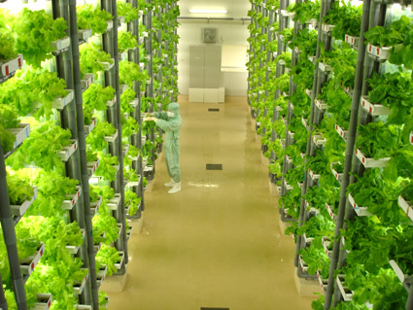
精緻農業高效節能植物工廠

Slide 77
ACE²S approach
Automation
自動監控、感測器開發
量測分析
平台建立系統整合與分析
自動化
環境
栽培
能源
Culture
栽培管理
肥培管理
葉片分析
病蟲害防治
Energy
隔熱/保溫
燈光/冷氣/運輸
節能/再生能源
Environment
光風水養氣

Slide 78
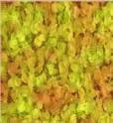
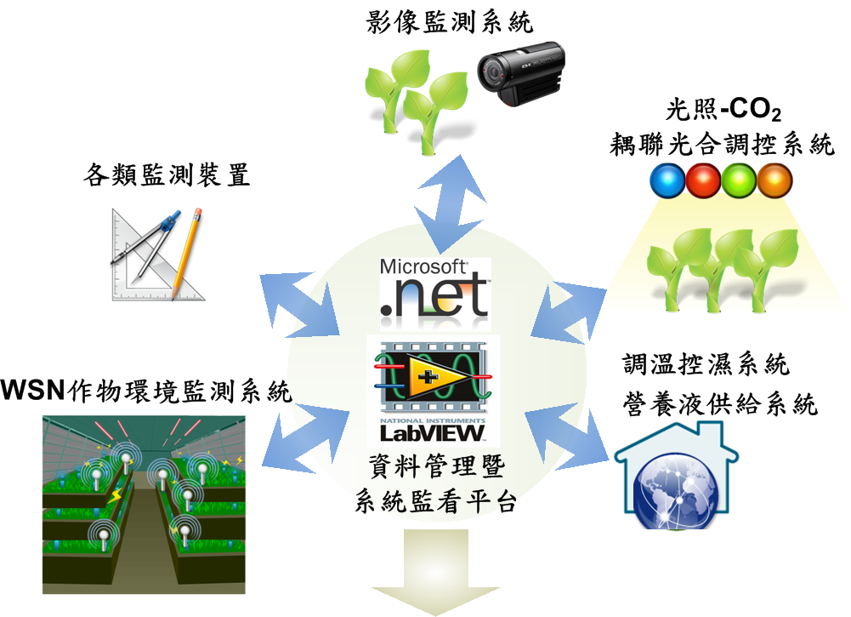
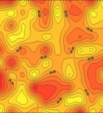
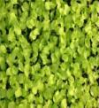
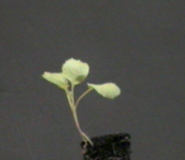
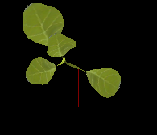
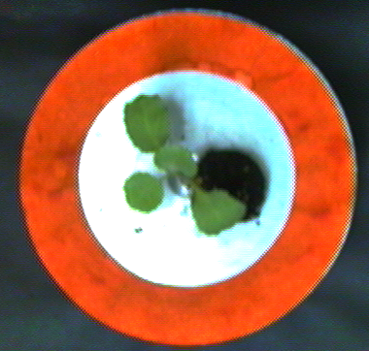
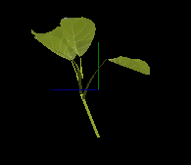
Automation

Slide 79

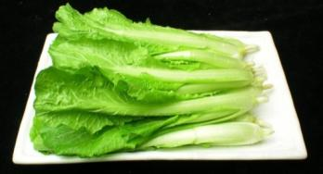
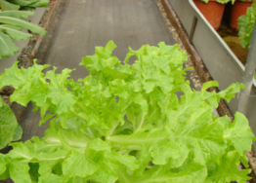
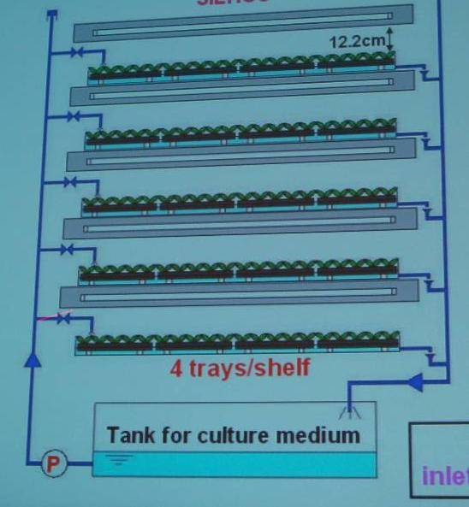
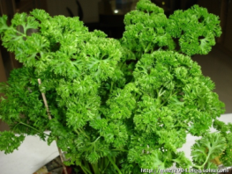
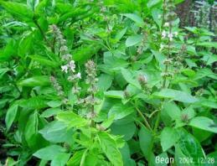
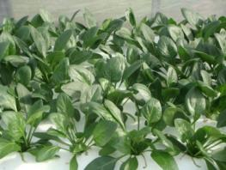
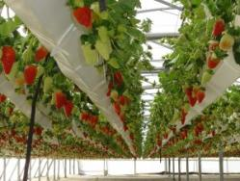
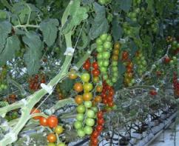
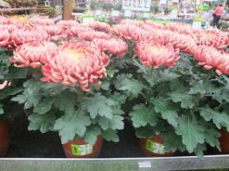
Culture
青梗白菜
小白菜
萵苣
洋芫荽
羅勒
菠菜
草莓
蕃茄
盆菊、粗肋草、火鶴花、蘭花種苗、水稻苗
Notes:
79
79

Slide 80
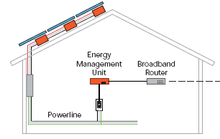
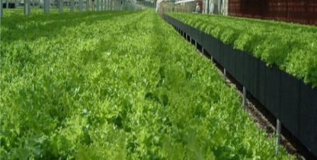


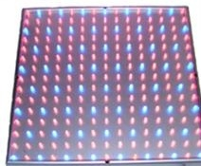
Environment
風：空氣溫、濕度、內循環風速
光：光量、光質、光週、均勻度
水：供給方式、供給時機、供給頻度
養：營養、供給方式/時機/頻度
氣：二氧化碳
Temperature
Humidity
Light

Slide 81
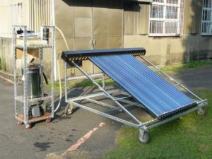
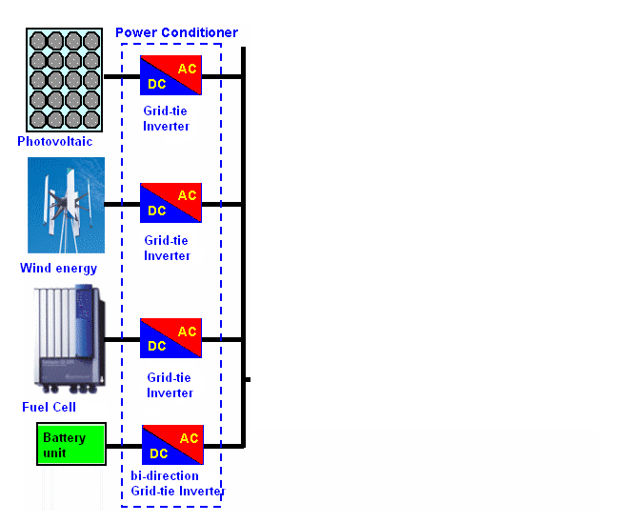

Energy
太陽光電
太陽電能製冷
81

Slide 82


System
經營、管理
決策支援
行銷、市場

Slide 83
目標
節能最大化
節水最大化
減排最大化
產能最大化
品質最佳化
行銷最大化
利潤最大化
…..
Capability
Value = -------------------------------
Problem x Cost

Slide 84
電腦輔助系統工程
Computer Aided
Systems Engineering
C.A.S.E.

Slide 85
思考
如何建立一個電腦軟體，讓不同專業領域的人，都可以用此工具來建立簡報 ?
範例：想想 MS Powerpoint 軟體的架構

Slide 86
思考
如何建立一個電腦軟體，讓不同專業領域的人，都可以用此工具來激發創意，進而創造發明 ?
如何濃縮整理既有的專利發明，物理、化學、數學等定律、法則與公式?
如何濃縮整理前人的經驗，演化的法則，進步的軌跡，歷史的規律?
範例：Triz、AskNature、ChatGPT

Slide 87

Triz (week6)
發明創造相關的
  靈感來源
  專利與文獻資料的彙整
AskNature (week9)
ChatGPT
ai.com
台灣仿生協會

Slide 88
思考
如何彙整所有的空氣熱力學性質?
如何才能方便查詢? 方便使用?
範例：
  濕空氣熱力特性圖 (熱力學教科書)
  Psychart 軟體 (方，1996)

Slide 89


Slide 90





Slide 91
結論
不自我設限：觸類旁通、異中求同、同中求異
資源有限
最佳化利用
如何評估?
  工程經濟是基礎
  善用工具、善用資源
Do more with less 才是專業
態度決定一切

Slide 92
課程大綱
Mindset (態度)
工程經濟 (Engineering Economic)
最佳化 (optimization)
Triz 簡介 (創造發明工具庫)
學與思
  學習如何學習：快速記憶的技巧，向大自然學習 (生物模擬)
  思考如何思考：了解你的思考模式
應用範例：
  ACESys相關：農業、溫室產業、養殖業、植物工廠
  跨領域：LED在生物產業應用，水產業，空調熱泵與其在生物產業應用
  MIT 校友 24 步驟創三萬家公司
另類系統工程：
  河圖、洛書、八卦與魔術方陣
  系統工程看中醫

Slide 93
生機系核心課程
每學年下學期

