Slide 1
^{簡介}系統工程
台大生機系 方煒

Slide 2
生機系的領域
生命科學與工程的整合
Engineering
Bring engineering to life
Bring life to engineering
Life/Biology

Slide 3
生物機電
Bio-mechatronics
向大自然學習
Learn from the Nature
觸類旁通
異中求同

Slide 4
An example on
‘parallel installation of compressors’

Slide 5
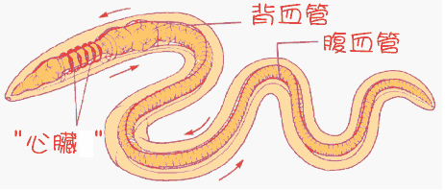

Slide 6
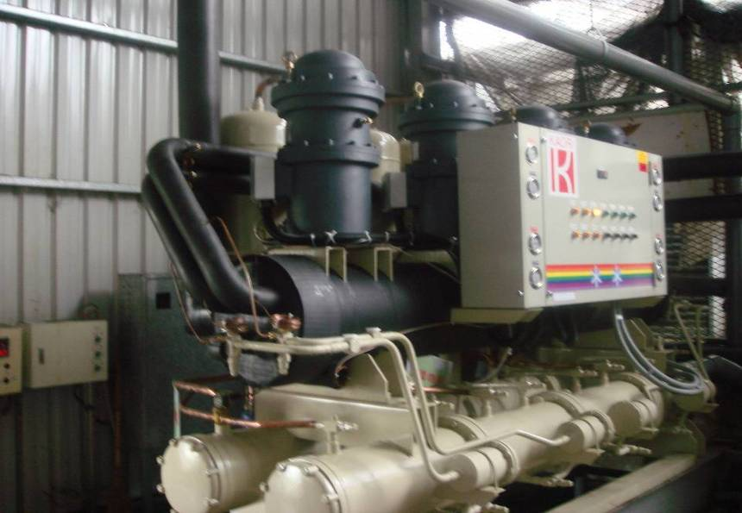
多台壓縮機並聯

Slide 7
An example on
‘parallel distribution of pipes’

Slide 8
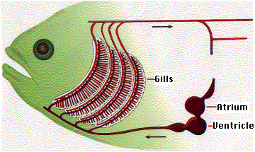
心房
心室

Slide 9
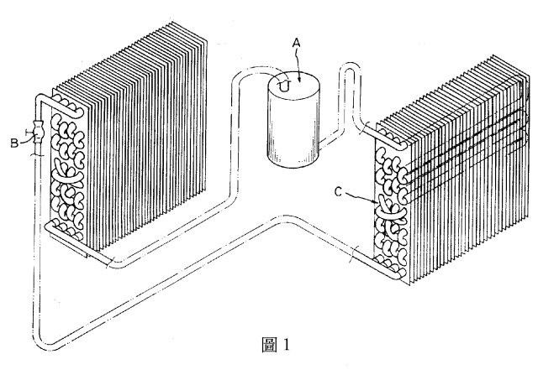
冷媒流向：分流，對調與合流
C
冷排
熱排
均勻吸熱
均勻散熱

Slide 10
An example on
‘3 head pipes for even distribution’

Slide 11
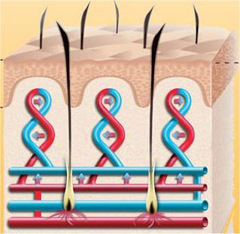
血管：如何均勻輸送
3 head pipes

Slide 12
傳統 地底加熱系統1

Slide 13
傳統 地底加熱系統2

Slide 14
修正的 地底加熱系統

Slide 15
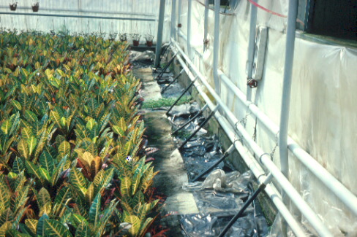
修正的溫室地底加熱系統
3 head pipes

Slide 16
An example on
‘oxygen/heat exchange’

Slide 17
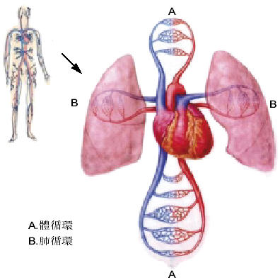

Slide 18
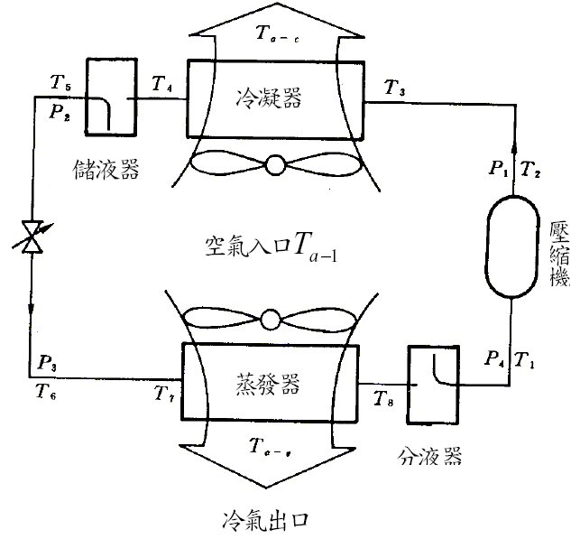
傳統 冷凍空調系統
熱氣出口

Slide 19
血液循環 | 冷凍空調
血管缺乏舒張壓就没有彈性位能，血管與器官都會扁掉 | 冷媒管缺乏低壓側壓力，大氣壓力與壓縮機的負壓會把冷媒管壓扁
收縮壓 (血液擠向動脈) 動態調配血液的力量 | 高壓側壓力
舒張压 (血液由動脈流出) 保持血管彈性的力量 | 低壓側壓力 讓冷媒流回壓縮機的力量
體循環供給身體氧氣 | 高壓側散熱
肺循環交換取得氧氣 | 低壓側吸熱

Slide 20
右心房
Modified 冷凍空調系統
右心室
熱氣出口
三尖瓣
動脈
靜脈
身體
右肺動脈
左心房
左肺動脈
二尖瓣
肺臟
左心室

Slide 21
An example on
‘accumulator vessel’

Slide 22
心房
心室

Slide 23
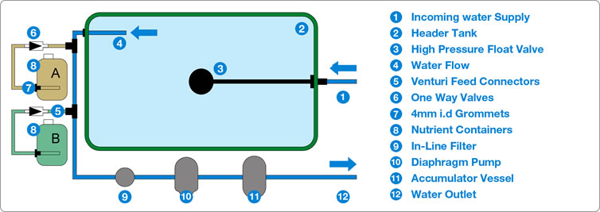

Slide 24
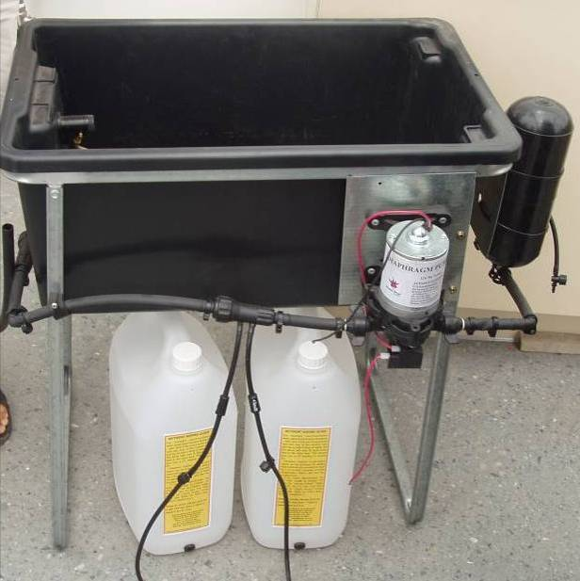

Slide 25
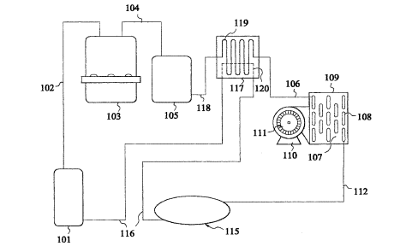
Modified 冷凍空調系統
熱回收裝置
壓縮機
Accumulator
冷凝器/熱排
蒸發器/冷排
膨脹閥

Slide 26
What a wonderful world

Slide 27
更多範例
觸類旁通、異中求同
太極理念應用於冷凍空調系統之研發

Slide 28
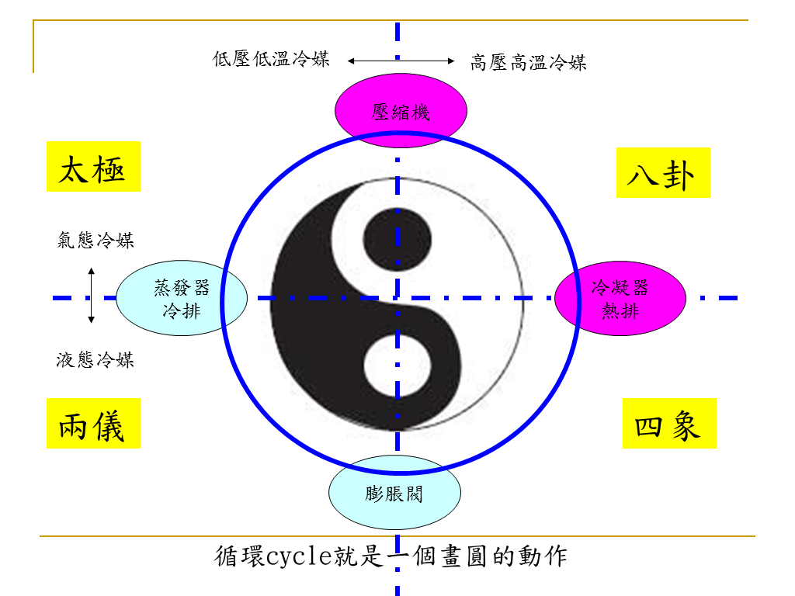

Slide 29
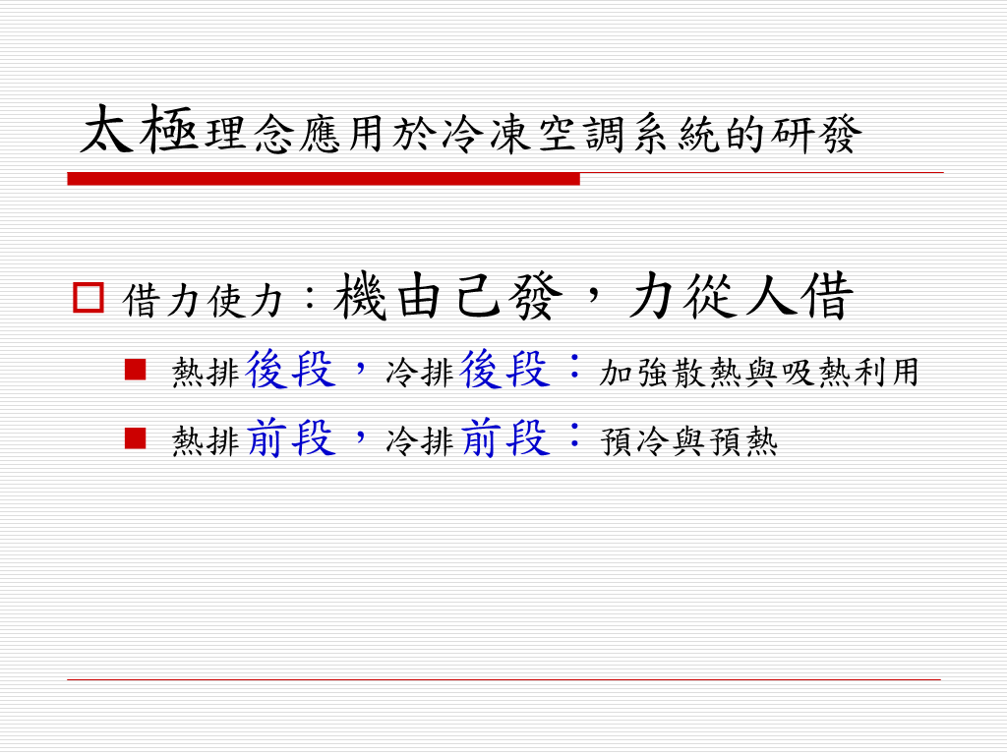

Slide 30
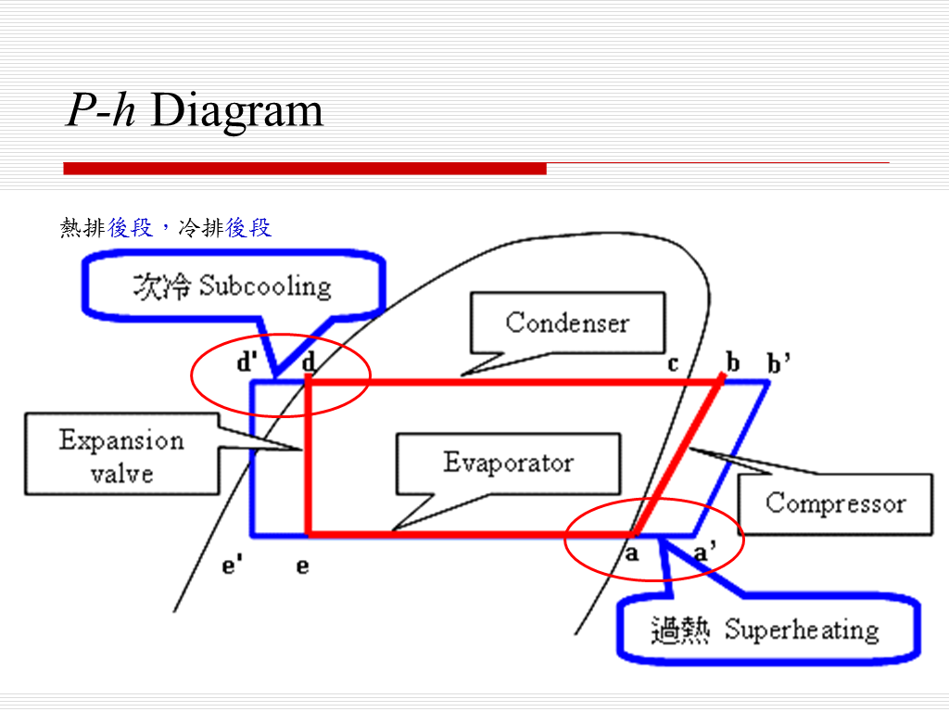

Slide 31
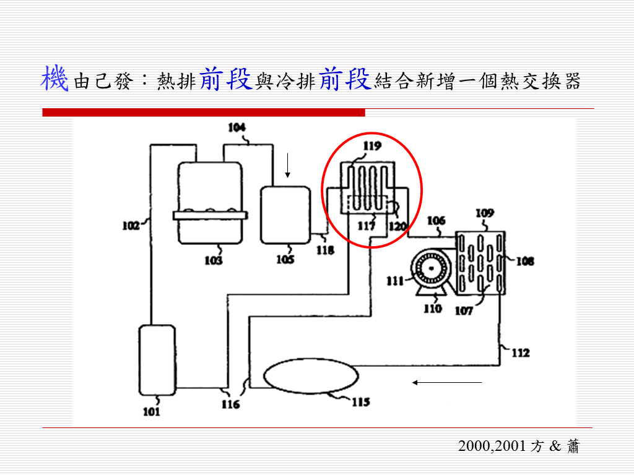

Slide 32
更多範例
觸類旁通
發散式思考

Slide 33
水
水產業 --> 關鍵的就會成為趨勢

Slide 34
水產業
提供潔淨的淡水：水處理
提供美容、醫療功能的水：機能水
提供滅菌功能的水：電解水
提供量化指標：檢測儀器、感測器
物理法、化學法、生物法
物化法、生化法、生物物理法

Slide 35
光
人工照明 --> 需求引導趨勢

Slide 36
LED 應用於生物產業
美容醫療：
  柔光回春
  免疫提升
  光動力療法
照明：路燈、車燈、室內照明
植物照明：光質、光量、光週
經濟動物催情、肌肉增生
昆蟲誘捕、水下魚蝦誘引
檢測儀器

Slide 37
更多範例
吾道一以貫之
相通技術應用於不同對象
範例：
  環控農業
    環控：地上環境、地下環境 (水下)
    農業：廣義定義包含農漁牧

Slide 38
CEA 環控農業
Controlled Environment Ag/Aq/Ap
  Ag: Agriculture
    CEPPS: Plant Production System 環控作物量產系統
    CEAPS: Animal Production System 環控動物量產系統
  Aq: Aquaculture 循環水養殖
  Ap: Aquaponic 複合養殖

Slide 39
Controlled Ecological Ag/Aq/Ap
生態控制下的廣義農業/養殖漁業/複合養殖
何謂生態控制?
  系統內的生產者、消費者、分解者能時時維持平衡
  允許穩態量產

Slide 40
NASA太空農業計畫
  系統內的生產者、消費者、分解者必需時時維持平衡
ALSS: Advanced Life Support System
BLSS: Bio-regenerative Life SS
CELSS: Controlled Ecological Life SS

Slide 41
A Schematic ALSS
Crew
Space
Plant
Growth
Unit
De-
humidifier
Air
Purifier
Water
Purifier
Food
Processing
Unit
Waste
Processing
Unit
Air
Water
(After M.M. Averner, 1989)
Biomass

Slide 42
何謂 穩態量產 ?
循環水養蝦、養藻與養牡蠣
如何確保能夠穩態量產
  假設生產期程需要 16 週
  生產系統便需要 16 套
  每週供應固定數量的飼料
  每週收穫固定數量的產品

Slide 43
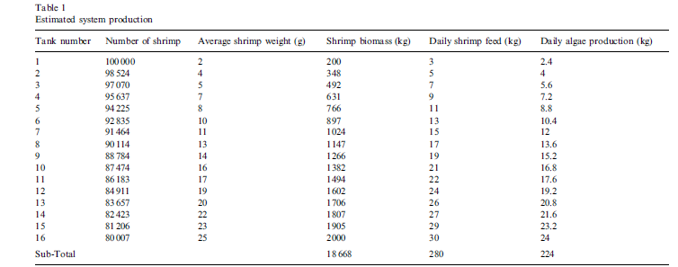
a microalgae-based recirculating oyster and shrimp system
每天隨時有 18668 kg 的蝦子在養數量
每週可收穫 2000 kg 的蝦子
每天餵飼 280 kg 的飼料
每天產出 224 kg 的藻類
每天產出 112 kg 的牡蠣肉，相當於 700 kg 的牡蠣

Slide 44
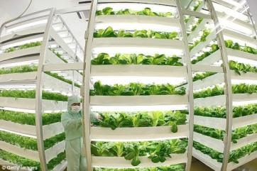
何謂 穩態量產 ?
立體化短期葉菜類栽培
35天生長期
育苗 14 天，育成 21 天
  3套系統 → 每週收穫
  21套系統 → 每天收穫
育苗 21 天，育成 14 天
  2套系統 → 每週收穫
  14套系統 → 每天收穫
一年收穫 18 次
一年收穫 26 次

Slide 45
甚麼是 Phytomation ?
由設施農業 (Protected cultivation)
發展到環控作物生產系統 (Controlled Environment Plant Production Systems )
再下一步的進階就是Phytomation

Slide 46
From Protected Cultivation
to Controlled Environment Plant Production Systems
to Phytomation
Phytomation
* Protected cultivation
** Controlled Environment
Plant Production Systems
ACESys
Environment
Friendliness
NJ-NSCORT
for ALSS
Applied
Intelligence
Growing
Systems
Phyto-
remediation
Operations
Research
Production
Environment*
CEPPS**
Greenhouse
Structures

Slide 47
A
E
E
Sys
C
E
Plant Quality

Slide 48
Automation-Culture-Environment-Systems (ACESys) Oriented Approach to Phytomation
AUTOMATION: Machine Capabilities of Perception; Reasoning & Learning; Communication; and Task Planning & Execution
Automation and Culture
Automation and Environment
SYSTEMS: Studies, Analysis, and Integration for overall Technical Workability, Economic Viability, Energy Efficiency, Ecological Harmony, Social & Political Issues, Optimization, and Management
ENVIRONMENT: The Surroundings and processes including Air, Water, Soil, and controlled environment
CULTURE: Biology and Cultural Practices of crops
Culture and Environment

Slide 49
Concept of
Automation-Culture-Environment Oriented Systems Analysis (ACESYS)
Components and Processes of Controlled Environment Bio-Production Systems may be categorized into three classes: (K.C. Ting, 1994)
Automation – machine capabilities of information processing and physical work (including perception, reasoning/learning, communication, and task planning/execution)
Culture – factors and practices that can directly describe and/or modify the growth and development of biological objects (e.g. morphological and physiological conditions, as well as cultural tasks including multiplication, nutrient delivery, disease prevention, harvesting, etc.)
Environment – surroundings of biological objects (including climatic, nutritional, structural, and mechanical conditions)

Slide 50
Automation
Information Processing & Task Execution, e.g.
Perception
Reasoning / Learning
Communication
Task Planning & Execution

Slide 51
Culture
Factors and Practices which can Describe and/or Modify Growth and Development of Biological Objects, e.g.
Plant Support & Operations
Nutrient Distribution
Micro-Environment
Contained Root Zone
Root Aeration

Slide 52
Environment
The Surrounding of Biological Objects, e.g.
Radiative, Thermal
Gaseous, Liquid
Physical, Chemical, Biological

Slide 53
ACESys 架構
& Learning
Plant Quality

Slide 54
Application of ACESYS to Phytomation Systems (i.e. using ACESYS to describe and implement Phytomation systems)
Applications Technologies | (A) Protected Cultivation | (B) Green-house | (C) Controlled Envir. Plant Production Systems | (D) Other Plant Based Engineering Systems
Automation
Culture
Environment
Systems
Implementation
Strategy for artificial lighting in Single Truss Tomato Cropping System
(Ting, Fang, et al.)
Plant factory for Phalaenopsis young plant production
(Fang)
PF in NTU (Fang)
ALSS, NASA
(Ting)
Greenhouse Cooling / Heating

Slide 55
STTCS 單果串番茄量產系統
Applications Technologies | Single Truss Tomato Cropping System
Automation | Artificial lighting Fan & Pad, Ebb & Flood, Chiller
Culture | Cultural practice Varieties
Environment | Local weather, Indoor environment, Structure, walls Light quantity, quality, Air T, RH, CO₂, Water T, DO, EC,pH, etc.
Systems | Engineering economic analysis, Number of crops per year, other DSS

Slide 56
GH_cooling / heating
Applications Technologies
Automation | Control system: hardware/software Various means to cool / heat the GH
Culture | Cultural practice
Environment | Local weather, Indoor environment, Structure, walls Light quantity, quality, Air T, RH, CO₂, Water T, DO, EC,pH, etc.
Systems | Engineering economic analysis, Risk analysis, other DSS

Slide 57
Plant Factory of Phalaenopsis
Applications Technologies | Controlled Environment Plant Production Systems
Automation | Moving light, Multi-layer benches Fan & Pad, Ebb & Flood, Chiller
Culture | 12 cm leaf span young Phalaenopsis Flower forcing of 30 cm leaf span young Phalaenopsis
Environment | Local weather, Indoor environment, Structure, walls Light quantity, quality, Air T, RH, CO₂, Water T, DO, EC,pH, etc.
Systems | Engineering economic analysis, Risk analysis, other DSS

Slide 58
Plant Factory in NTU
Applications Technologies | Controlled Environment Plant Production Systems
Automation | Artificial light, Multi-layer benches Environmental control, Fertigation Nondestructive quality/nutrient detection
Culture | Leafy greens
Environment | Structure, walls Light intensity, quality, duration Air T, Wind speed, RH, CO₂, Water T, DO, EC, pH, etc.
Systems | Engineering economic analysis, Growth model, other Decision Support System

Slide 59
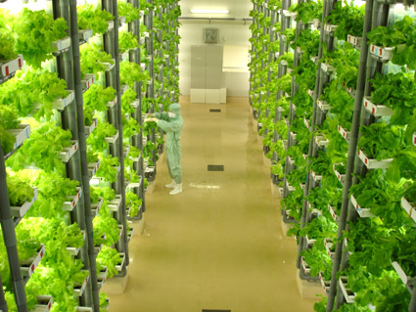
精緻農業高效節能植物工廠

Slide 60
ACE²S approach
Automation
自動監控、感測器開發
量測分析
平台建立系統整合與分析
自動化
環境
栽培
能源
Culture
栽培管理
肥培管理
葉片分析
病蟲害防治
Energy
隔熱/保溫
燈光/冷氣/運輸
節能/再生能源
Environment
光風水養氣

Slide 61
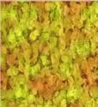
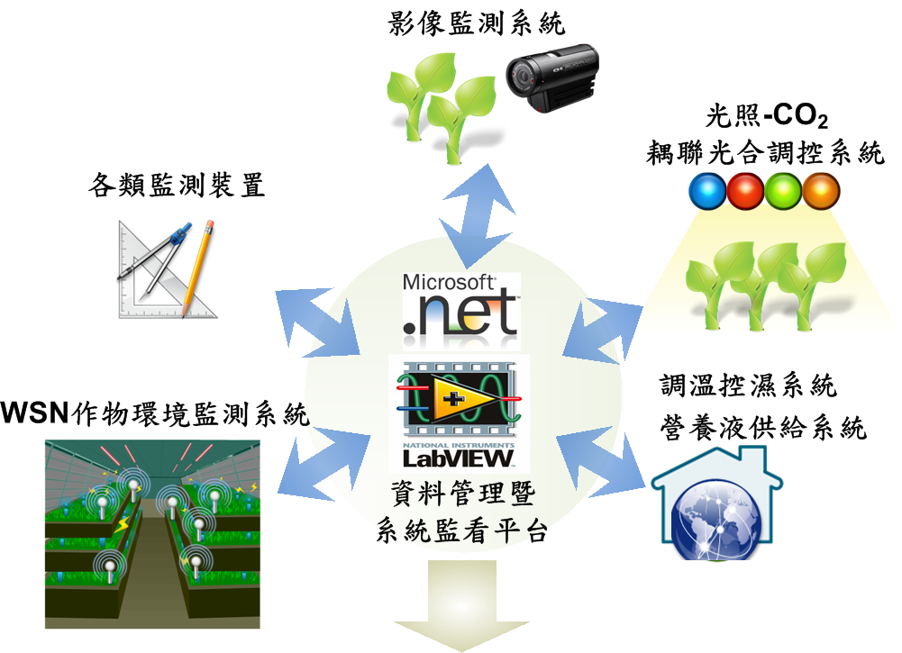
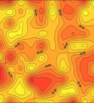
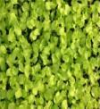
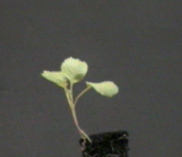

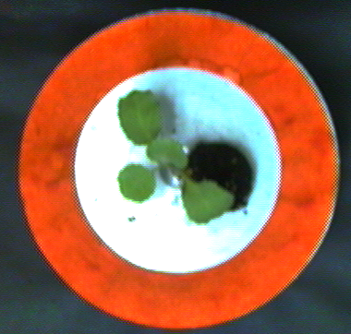

Automation

Slide 62

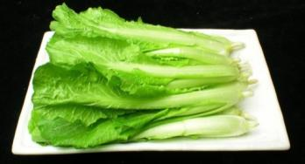
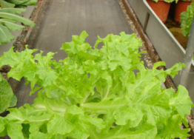
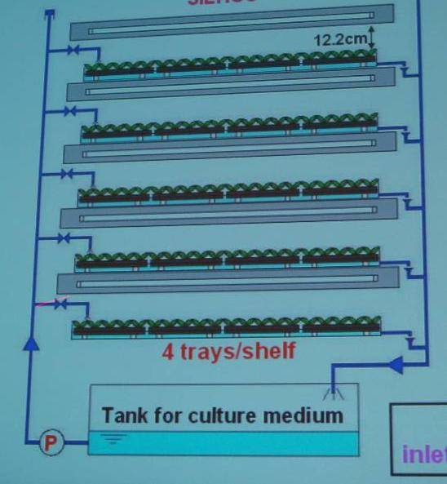
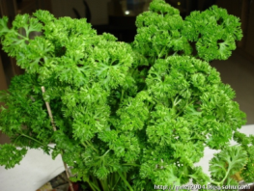
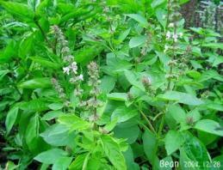
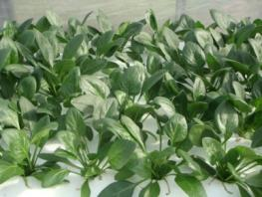
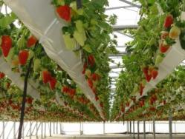
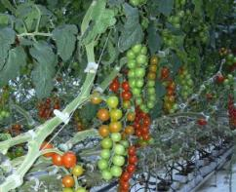
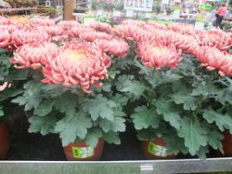
Culture
青梗白菜
小白菜
萵苣
洋芫荽
羅勒
菠菜
草莓
蕃茄
盆菊、粗肋草、火鶴花、蘭花種苗、水稻苗
Notes:
62
62

Slide 63
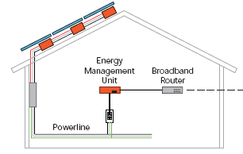
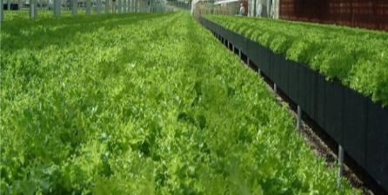


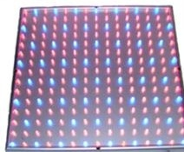
Environment
風：空氣溫、濕度、內循環風速
光：光量、光質、光週、均勻度
水：供給方式、供給時機、供給頻度
養：營養、供給方式/時機/頻度
氣：二氧化碳
Temperature
Humidity
Light

Slide 64
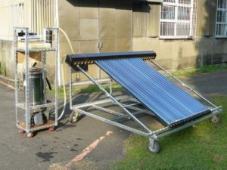
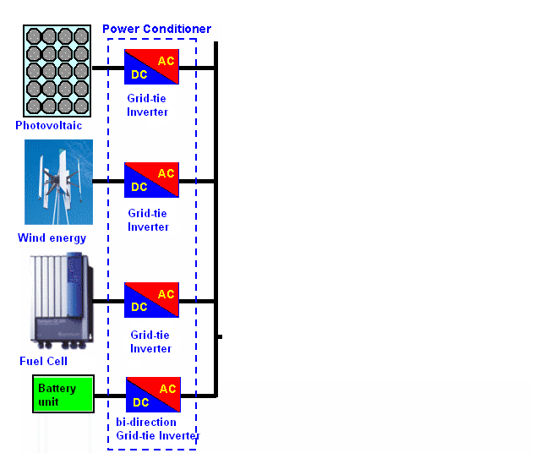
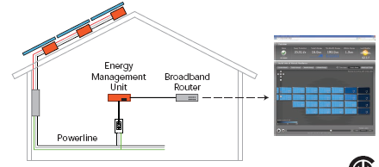
Energy
太陽光電
太陽電能製冷
64

Slide 65
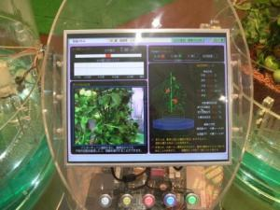
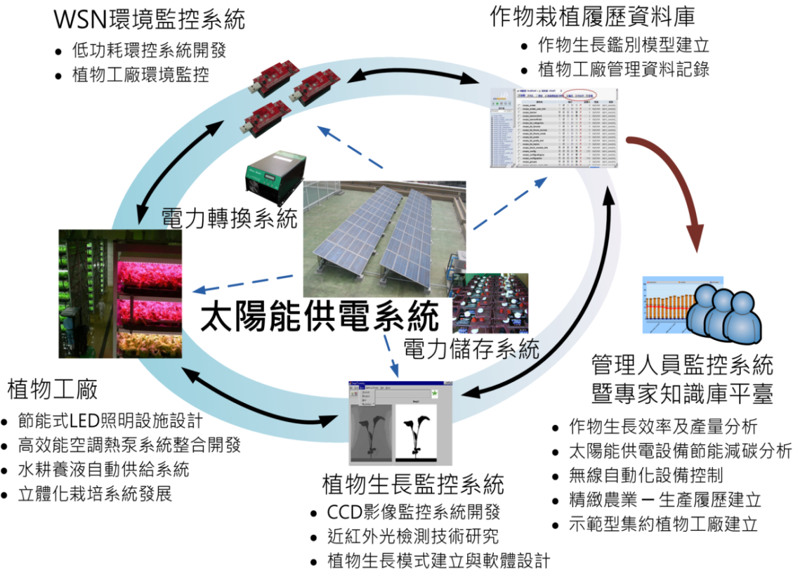
System
經營、管理
決策支援
行銷、市場

Slide 66
目標
節能最大化
節水最大化
減排最大化
產能最大化
品質最佳化
行銷最大化
利潤最大化
…..
Capability
Value = -------------------------------
Problem x Cost

Slide 67
電腦輔助系統工程
Computer Aided System Engineering
C.A.S.E.

Slide 68
思考
如何建立一個電腦軟體，讓不同專業領域的人，都可以用此工具來建立簡報 ?
範例：想想 MS Powerpoint 軟體的架構

Slide 69
思考
如何建立一個電腦軟體，讓不同專業領域的人，都可以用此工具來激發創意，進而創造發明 ?
如何濃縮整理既有的專利發明，物理、化學、數學等定律、法則與公式?
如何濃縮整理前人的經驗，演化的法則，進步的軌跡，歷史的規律?
範例：想想 Triz 軟體的架構

Slide 70
思考
如何彙整所有的空氣熱力學性質?
如何才能方便查詢?
如何才能方便使用?
範例：
  濕空氣熱力特性圖 (熱力學教科書)
  Psychart 軟體 (方，1996)

Slide 71
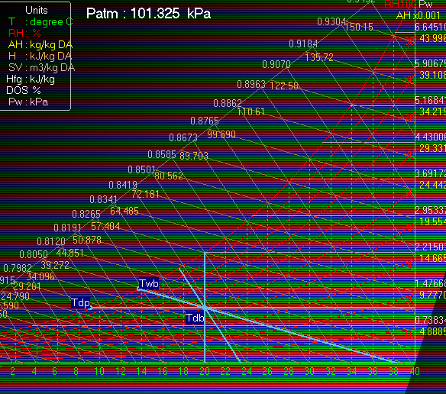

Slide 72
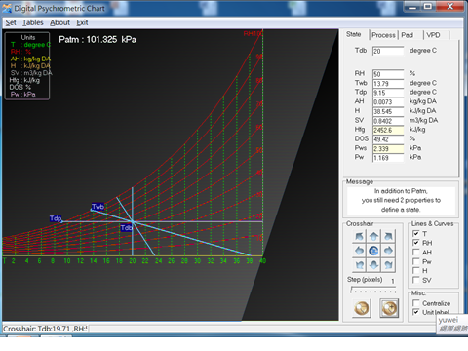
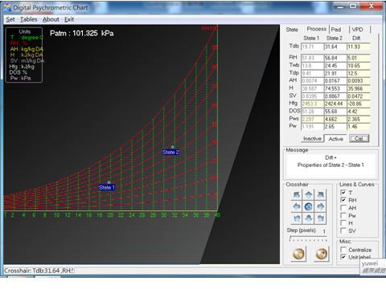
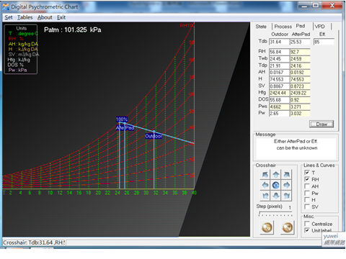
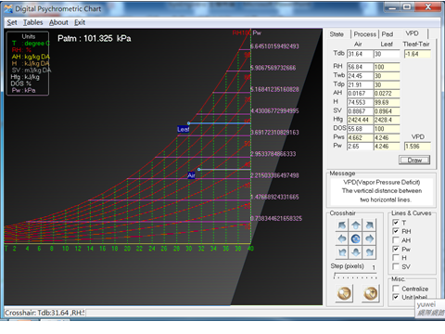

Slide 73
甚麼是 系統?
Depends on the system hierarchy, the system being addressed by one group could be the sub-system of another group and the super-system of a third group.
Concept #1
Concept #2
Concept #3
Concept #4
A system is a construct or collection of different elements that together produce results not obtainable by the sub-system alone.
Every system has life cycle. The life cycle of a system commences with identification of need and ends with disposal of the system.
Development of a system must consider the system life cycle.

Slide 74
System Concept #1
Depends on the system hierarchy, the system being addressed by one group
could be the sub-system of another group and the super-system of a third group.
Satellite
System
Satellite
Super-system
Satellite
Spacecraft Bus
Sub-system
Spacecraft Bus
System
Spacecraft Bus
Super-system
Power
Power
Sub-system
Power
System
Battery
Battery
Battery
Sub-system

Slide 75
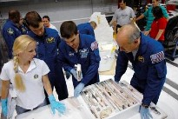
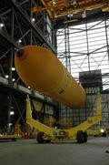
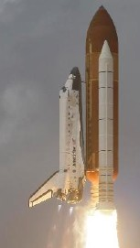
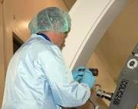
System Concept #2
A system is a construct or collection of different elements that together produce results not obtainable by the sub-system alone.
Personnel
Facilities
Product
Processes

Slide 76
System Definitions
An integrated composite of people, products, and processes that provide a capability to satisfy a stated need or objective. (DSMC)
An integrated set of equipment, computer program, facilities, human and logistical support resources, and procedures which are assembled to accomplish a single purpose or mission. (NASA)
A composite of equipment, skills, and techniques capable of performing and/or supporting and operational role. (Army)
A system can be broadly defined as an integrated set of elements that accomplish a defined objective. (INCOSE)
Hardware
Software
Equipment
Technical Data
Facilities
Personnel
DSMC: Defense System Management College

Slide 77


Characteristics of a System
In summary, a system contains the following characteristics:
  A system constitutes a complex combination of resources in the form of
  human, materials, equipment, facilities, data, skills, procedures, etc.
  A system may be broken down into subsystems and related components,
  the extent of which depends on complexity and the functions being
  performed. However, properties of the system can only be assessed
  and measured once the components have been integrated into a system
  as a whole rather than derived from the properties of components.
  The system must have a purpose. It must be functional, be able to respond
  to some identified need.
Honey! Why I end up doing all the dirty housework?
Because we are a SYSTEM!

Slide 78

System Thinking
The system definition is important to the concept of “system thinking”
in developing a complex system.

Slide 79
System Concept #3
Every system has life cycle. The life cycle of a system commences
with identification of need and ends with disposal of the system.
In between the system life cycle, there are a numbers of system phases,
each of which builds on the results of the proceeding phase.
There is no universally acceptable agreement on how many phases exist
in a system life cycle or what those phases are called. In general, the
system life cycle can be divided into two broad phases: acquisition phase
and utilization phases.
  The activities in the acquisition phase varies according to complexity of the
  system but basically include requirements definition, design, and production.
  The utilization phase includes system operation and maintenance support,
  retirement or disposal of the system.

Slide 80


System Concept #4
Development of a system must consider the system life cycle.
The significance of focusing on the system life is that decisions made in
the acquisition phase may impact the intended activities in the utilization
phase and vice versa. For example, the design of the space shuttle must
take into account the maintenance and operation of the space shuttle
during the utilization phase. The reliability and availability of the space
shuttle during the utilization phase will also impact design of the shuttle.
I wonder what is my life cycle with this company

Slide 81
甚麼是 系統工程?
System Engineering Aproach (SEA)
是一套方法
是一種工具
用來了解/解決所面對的複雜/大型的議題
同樣適用於單純/小型的議題

Slide 82
Basic Concepts of Systems Engineering Process
Concept #1: Top-down approach.
  System engineering begins by addressing the complex system as a whole,
  which facilitates the initial allocation of requirements as well as the
  subsequent analysis of the system and its interfaces. Once system level
  requirements are understood, the system then broken down into
  subsystems and the subsystems further broken down into components
  until a complete understanding is achieved of the system from top to
  bottom.
Concept #2: Focus on life cycle.
  System engineering is focused on the entire system life cycle for decision
  making. Design solutions will not be selected only based on the issues
  associated with the acquisition phase but also considering potential issues
  which may cause in the utilization phase.

Slide 83
Basic Concepts of Systems Engineering Process
Concept #3: System optimization and balance:
  Combination of optimized subsystems does not necessary lead to an optimized
  system. The system engineering must derive a balance system between large
  number of requirements.
Concept #4: Integration of disciplines:
  System engineering aims to integrate the efforts of multitude technical
  disciplines to ensure that all user requirements are adequately addressed.
  The aims of system engineering is to break up the task into components
  that can be developed by respective specialties and to integrate their efforts
  to produce a system that meets the system goals.

Slide 84
Basic Systems Engineering Process
Mission
(A Large Problem)
SYSTEMS ENGINEERING PROCESS
(TO BE DECOMPOSED INTO AN INTEGRATED SET OF SMALL PROBLEMS)
#1
#2
#3
#N
TO BE SOLVED & EFFECTIVELY MANAGED TO PRODUCE
AN
OPTIMIZED SOLUTION

Slide 85
Basic Systems Engineering Process
System Control
Mission
Objectives
Requirement Analysis
Function Analysis & Allocation
#1
#2
#N
System Design & Synthesis
An
Optimized Solution

Slide 86
Why Need System Engineering?
Development of any large systems would need system engineering due to
the fact that large system will have the following features:
  Large resources:
    Resources must be combined in an effective manner. It is too risky to
    leave this into chance alone.
  Complicated hierarchy:
    The system being addressed is highly influenced by the performance
    of the higher level system, and these external factors must be evaluated.
  Complicated interface among subsystems and components:
    It is impossible to produce an effective design by considering each
    subsystem or component separately. One must view the system as a
    whole, break down the system into components, study the components
    and their interrelationships, and then put the system back together.
  Very costly for late changes:
    A well-defined process needs to be implemented to minimize the chances
    of late changes.

Slide 87
結論
不自我設限：觸類旁通、異中求同、同中求異
資源有限
最佳化利用
如何評估?
  工程經濟是基礎
  善用工具、善用資源
Do more with less 才是專業
態度決定一切

Slide 88
課程大綱
Introduction
Mindset (態度)
工程經濟 (Engineering Economic)
最佳化 (optimization)
Triz 簡介 (創造發明工具庫)
全球專利資料庫
Xmind (軟體工具)
學與思
  學習如何學習：快速記憶的技巧 (Mind mapping)，向大自然學習 (生物模擬)
  思考如何思考：了解你的思考模式
應用範例：
  ACESys相關：農業、溫室產業、養殖業、植物工廠
  跨領域：LED在生物產業應用，水產業，空調熱泵與其在生物產業應用
另類系統工程：
  河圖、洛書、八卦與魔術方陣
  系統工程看中醫

Slide 89
生機系核心課程
每學年上學期(9月~1月)開課
歡迎修課或旁聽

