Slide 1


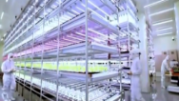
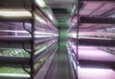
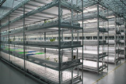
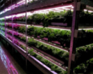
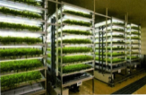
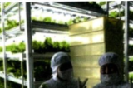
Plant Factory – Theory and Practice
PFAL System Design & Engineering Economic Analysis
Wei FANG
Dept. of Biomechatronics Engineering and and Global ATGS
Center of Excellence for Controlled Environment Agriculture (CCEA)
National Taiwan University
Notes:
1

Slide 2
Outline
Preface
All about COSTs
Growth parameters influence system design
Total Performance Evaluation (TPE)
How to…
1
2
3
4
5

Slide 3
    Proper prior planning
    prevents poor performance

Slide 4
Plan
DO
Check
Action
PDCA

Slide 5
Type of PFALs
Home appliance
Shop appliance
Research type
Hobby type
Mass production type
  Small scale: Daily harvest 300~500~1000 plants
  Middle scale: Daily harvest 1000~3000~5000 plants
  Large scale: Daily harvest > 5000 plants ~ 50000 plants

Slide 6
The following contents are more suitable for mass production type of PFALs.

Slide 7
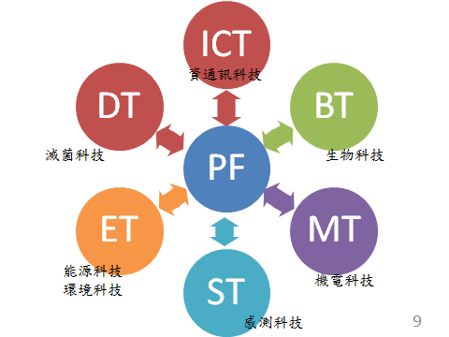
PFAL related
Info./commu. Tech.
Disinfection Tech.
Bio-Tech.
Energy Tech.
Environment Tech.
Mechatronics Tech.
Sensing Tech.

Slide 8
To guarantee the success
System: Properly design
HW, SW: Function properly
Quality of Product: Best/Super
Managing: Efficiently
Marketing: Branding, Multi-channel, Multi-product
Finance: Solid, Heathy

Slide 9
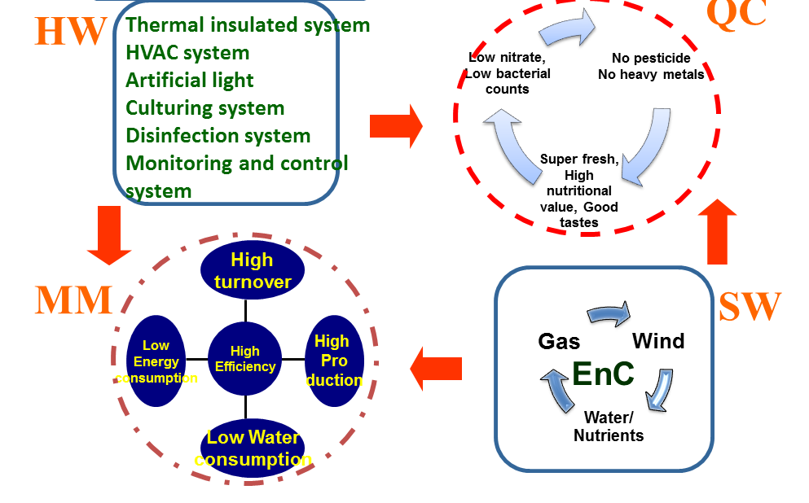
Keys/Traps/Opportunities
Product
SD
Air
Light
Gas
Water
Nutrient
Light
Environment

Slide 10
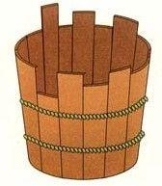
Integrated control is needed to function properly
Wind speed at 0.3~1 m/s
Proper leaf and air temperature
Bacteria controlled at least amount
CO₂ keep at 1000~2000 ppm
DLI < 14 for leaf lettuce, 17 mol/m² for Semi-head lettuce
Humidity keep at 70~85% (VPD at proper range)
EC content keep at proper range with little variation
風
光
溫
濕
氣
養
菌

Slide 11
Outline
Preface
All about COSTs
Growth parameters influence system design
Total Performance Evaluation (TPE)
How to…
1
2
3
4
5

Slide 12
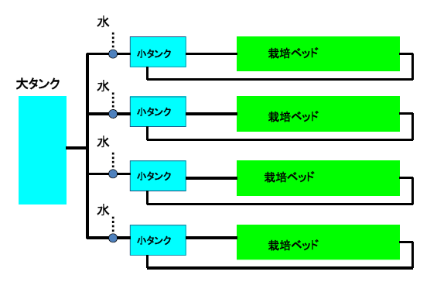
How to avoid cross contamination?
RO water
Big rich
Nutrient
tank
Nutrient solution tank
養液槽
栽培床
Cultural bed
Nutrient solution tank
栽培床
養液槽
Cultural bed
pH
EC
adjusted
Nutrient solution tank
Cultural bed
養液槽
栽培床
Nutrient solution tank
養液槽
Cultural bed
栽培床
12

Slide 13
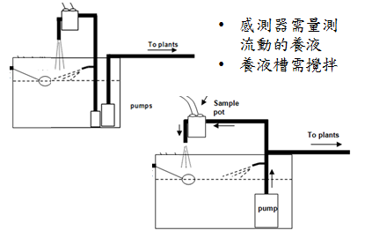
How to operate pump(s) in solution tank?
Required certain flow velocity of the nutrient solution to ensure accuracy of the sensor readout.
Need circulation in the tank to ensure rich in DO and improve uniformity of nutrients.
Intermittent type
Continuous type
13

Slide 14
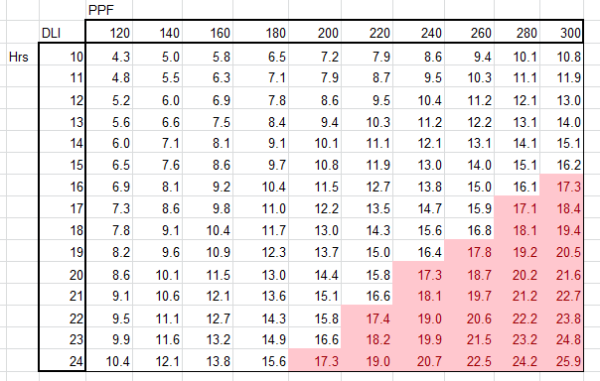
What is DLI (Daily Light Integral)?
DLI = f(PPFD, L)
PPFD: Photosynthetic Photon Flux Density, in micro-mole per square meter per second
Leafy lettuce
Semi-head lettuce

Slide 15
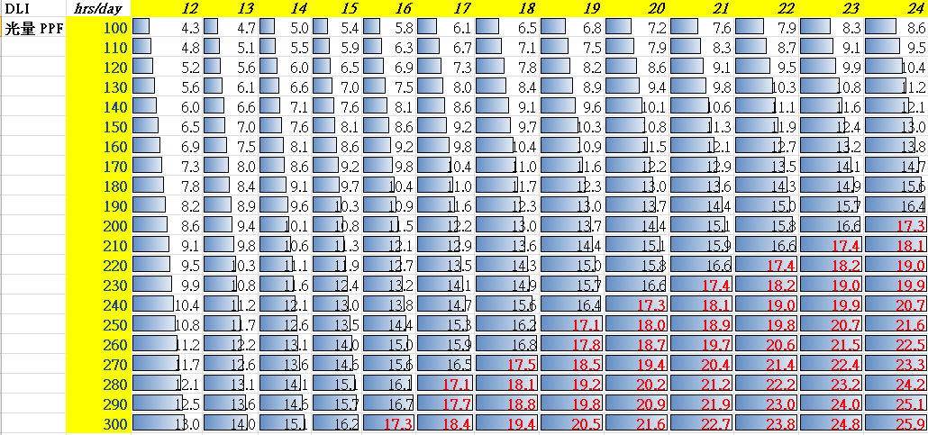
日累積光量 (DLI)
How to calculate Daily Light Integral (DLI)?
DLI = PPFD * L * 3.6 / 1000
DLI in mol/m²/day
PPFD in μmol/m²/s
L in hr/day
PPFD

Slide 16

日累積光量 (DLI)
Daily Light Integral (DLI)
PPFD

Slide 17
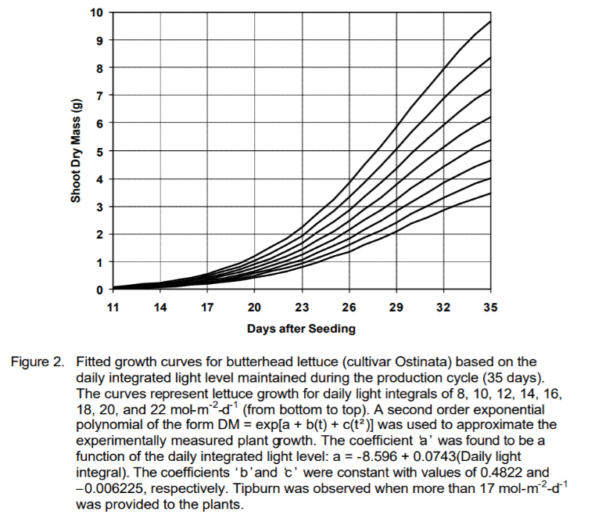
222
200
177
155
133
111
89
67
45
22
FM
22
20
18
16
14
12
10
8
DLI

Slide 18
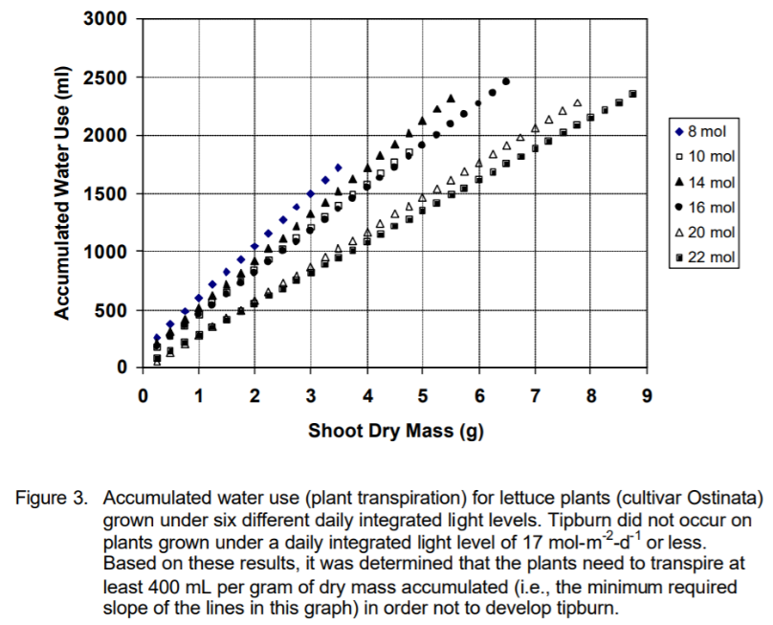
A.J. Both, 2003

Slide 19
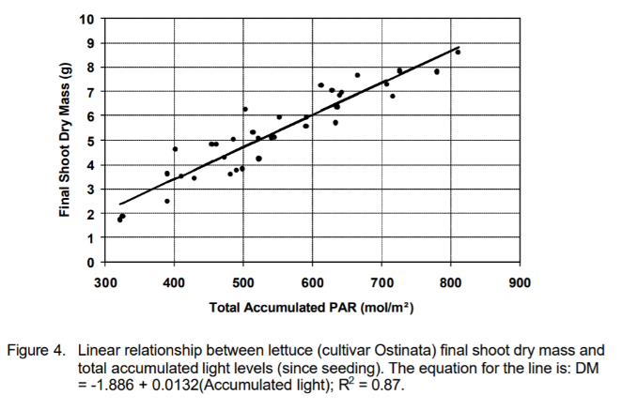
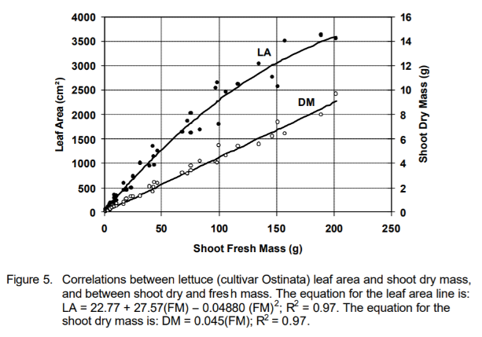
DM = 0.045 * FM
FM = DM / 0.045
100 g FM * 0.045 = 4.5 g DM
35 days
DLI = 8.57 11.42 14.3 17.14 20 22.85
TLI = DLI * Days
A.J. Both, 2003

Slide 20
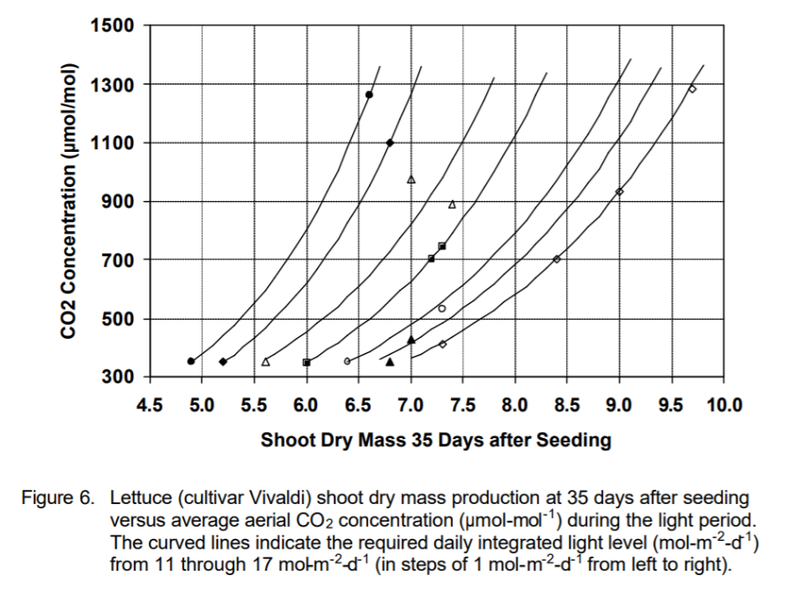
DLI = 11 12 13 14 15 16 17
A.J. Both, 2003

Slide 21
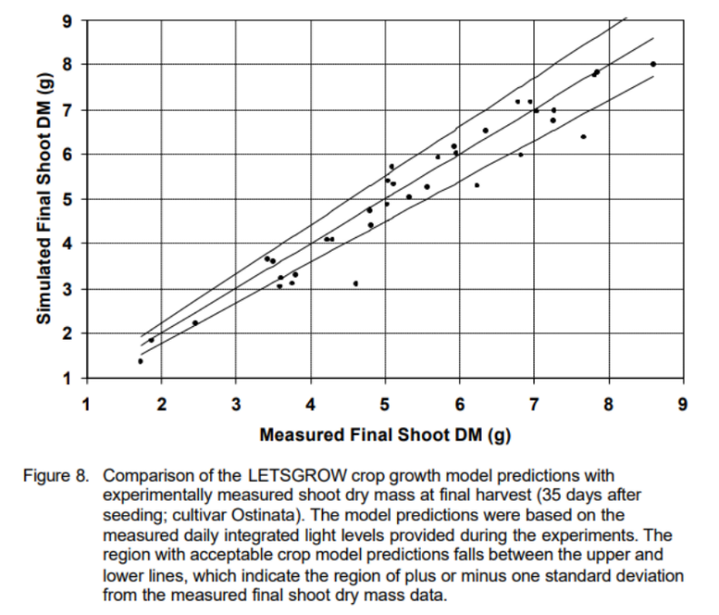
A growth model was developed based on DLI and CO₂ concentration.
A.J. Both, 2003

Slide 22
How to select the most profitable crops based on Engineering Economic Analysis (EEA)?

Slide 23
Which crop make the most profit?
 | Crop A | Crop B
Cost, NT$/plt | 20 | 200
Price, NT$/plt | 100 | 1000
Profit, NT$/plt | 80 | 800

Slide 24
Which crop make the most profit?
 | Crop A | Crop B
Cost, NT$/plt | 20 | 200
Price, NT$/plt | 100 | 1000
Profit, NT$/plt | 80 | 800
Cropping density, plt/m² | 25 | 10
Profit per unit area, NT$/m² | 2000 | 8000

Slide 25
Which crop make the most profit?
 | Crop A | Crop B
Cost, NT$/plt | 20 | 200
Price, NT$/plt | 100 | 1000
Profit, NT$/plt | 80 | 800
Cropping density, plt/m² | 25 | 10
Profit per unit area, NT$/m² | 2000 | 8000
Duration, month | 1 | 6
Annual profit per unit area, NT$/m²/yr | 24,000 | 16,000

Slide 26
Which crop make the most profit?
 | Crop A | Crop B
Cost, NT$/plt | 20 | 200
Price, NT$/plt | 100 | 1000
Profit, NT$/plt | 80 | 800
Cropping density, plt/m² | 25 | 10
Profit per unit area, NT$/m² | 2000 | 8000
Duration, month | 1 | 6
Annual profit per unit area, NT$/m²/yr | 24,000 | 16,000
Initial Investment, NT$/m² | 50,000 | 5,000

Slide 27
Cash Flow of Crop A & B
 | Crop A | Crop B | A-B | IRR
Year 0 Initial Investment, NT$/m² | 50000 | 5000 | -45000
Year 1 Annual Net Profit, $/m²/yr | 24,000 | 16,000 | 8000 | -82%
Year 2 | 24,000 | 16,000 | 8000 | -48%
Year 3 | 24,000 | 16,000 | 8000 | -26%
Year 4 | 24,000 | 16,000 | 8000 | -12%
Year 5 | 24,000 | 16,000 | 8000 | -4%
Year 6 | 24,000 | 16,000 | 8000 | +2%
Year 7 | 24,000 | 16,000 | 8000 | +6%
Pay back year: in between 5 to 6 years

Slide 28
Four rates for beginners
Interest rate
Inflation rate
Return rate
(internal rate of return, IRR)
Exchange rate

Slide 29
How to operate a PFAL to guarantee success?
Two more ‘rates’
Survival rate
Sale rate

Slide 30
Performance evaluation index:
Rate of Sale
Profit = Revenue – Cost
Price 30 NT$/plt，Amount 100 plants，Cost 20 NT$/plant
Rate of Sale 100%，Profit = (30 – 20) * 100 = 1000
Rate of Sale 70%，Profit = (30 – 20) * 100 * 0.7 = 700
?
30 * 0.7 * 100 - 20 * 100 = 100
30 * 0.7 * 100 - 20 * 100 = 100

Slide 31
Performance evaluation index: survival rate
plant 100 seeds, harvest 70 plants, harvest rate 70/100 = 70%
harvest 100 plants, how many seeds required? 100/0.7 = 142.8 = 143
(130 – 100)/100 = 30%
(130 – 100)/100 = 30%

Slide 32
Survival rate
Stages
  1. seeding
  2. seedling
  3. mature
All stages have survival rates to consider (SR₁, SR₂, SR₃)
Total survival rate SR = SR₁ * SR₂ * SR₃
  SR = 0.7 * 1.0 * 1.0 = 0.7
  SR = 0.9 * 0.9 * 0.9 = 0.729
Which is better? Why?
high SR is better?

Slide 33
Survival rate of all stages influencing Cost
SR = SR₁ * SR₂ * SR₃
  Case a: SR = 0.7 * 1.0 * 1.0 = 0.7
  Case b: SR = 0.9 * 0.9 * 0.9 = 0.729
Costs involved with depreciation + labor + utility + materials + marketing + other overhead cost
Assuming totally 100 plants, total cost= 20 NT$/plt
(cost in 3 stages are 3, 7, 10, respectively)
Cost = Amount x cost in each stage x accumulative SR of previous stage
  Case a: cost= 100 * (3 * 1 + 7 * 0.7 + 10 * 0.7) = 1490
  Case b: cost= 100 * (3 * 1 + 7 * 0.9 + 10 * 0.81) = 1740

Slide 34
Successful rate to grow and to sell are both critical

Slide 35
Sale (marketing) rate and survival rate
Net profit = Quantity x (price x sale rate x SR – sum of (cost of each stage x accumulative SR of previous stage))
Quantity: 100 plants
Cost: 20 NT$/plt (3, 7, 10 for each stage, respectively)
Price: 30 NT$/plt
Sale rate | Survival rate | Net Profit
100% | 100% | 100 * (30 – 20) = 3000 – 2000 = 1000
70% | 100% | 100 * (30 * 0.7 – 20) = 2100 – 2000 = 100
70% | 70% = 0.7 * 1 * 1 | 100 * [30 * 0.7* 0.7 – (3 * 1 + 7 * 0.7 + 10* 0.7)] = 1470 – 1490 = -20
70% | 72.9%= 0.9³ | 100 * [30 * 0.7 * 0.729 – (3 * 1 + 7 * 0.9 + 10* 0.81)] = 1531 – 1740 = -209

Slide 36
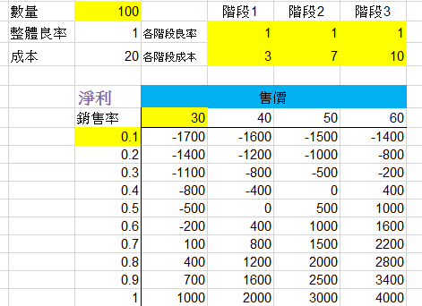
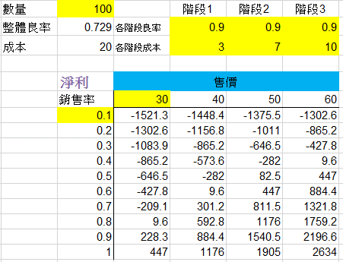
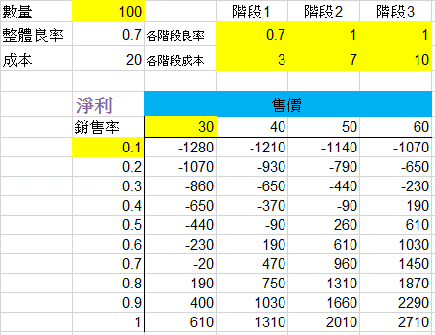
Quantity
Stage 1 2 3
Quantity
Stage 1 2 3
Survival rate
SR(i)
Survival rate
SR(i)
Cost
Cost(i)
Cost
Cost(i)
Net profit
price
Net profit
price
Sale rate
Sale rate
Quantity
Stage 1 2 3
When sale rate low, no need to enhance Survival rate (SR high, loss more)
When with same sale rate, SR high does not guarantee high profit. Still need to know SR(i).
SR(i) high in later stages are preferable.
Survival rate
SR(i)
Cost
Cost(i)
Net profit
price
Sale rate

Slide 37
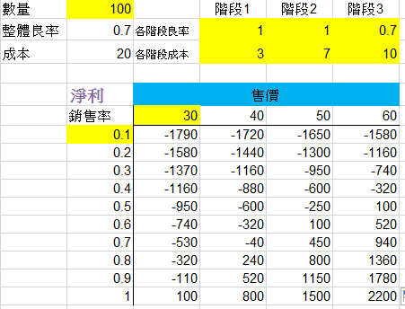
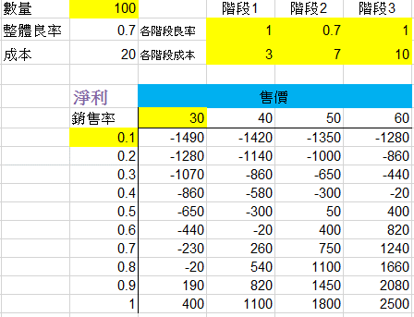
Quantity
Stage 1 2 3
Survival rate
SR(i)
Loss/elimination should happened as early as possible
Cost
Cost(i)
Net profit
price
Sale rate
Fail in early stage is a blessing to the business
Quantity
Stage 1 2 3
Quantity
Stage 1 2 3
Survival rate
SR(i)
Survival rate
SR(i)
Cost
Cost(i)
Cost
Cost(i)
Net profit
price
Net profit
price
Sale rate
Sale rate

Slide 38
Performance evaluation index
Annual profitability per area
Annual profitability per area
What kind of area:
  Floor area / Production area / Growth area
Example
  A PFAL can have annual net profit of 4 Million NT$
  1000 m² / 500 m² (50% for plant production) /2000 m² (4 tiers)
  Annual profitability per area equals
    4000 NT$/m² floor area/year
    8000 NT$/m2 production area/year
    2000 NT$/m2 growth area/year
Based on these numbers and expected payback years, one can determine the reasonable amount of investment.

Slide 39

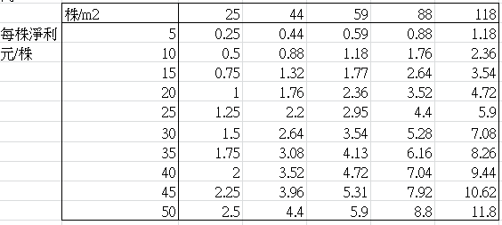
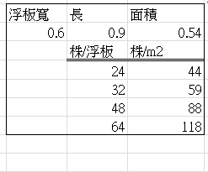
Expected payback year is 4 years.
The investment should not exceed 2.36 * 4 = 9.44 x 10 k NT$ per meter
Based on growth area
Batches per year
Plt/m²
5 NT$/plt * 25 plt/m2 * 20 = 0.25 x 10k NT$/m2/yr
Net profit
NT$/plt
10k NT$/m2/yr
Size of panel m²
Plt/panel
Plt/m²
100% sale rate and SR
Assuming 30 plants per panel was used,
A crop with 20 NT$ per plant of net profit was selected.
Annual production can have 20 batches per year.

Slide 40
Outline
Preface
All about COSTs
Growth parameters influence system design
Total Performance Evaluation (TPE)
How to…
1
2
3
4
5

Slide 41
Costs
Operating costs
  depreciation
  utility
  labor
  materials
  managing
  Sale
  Misc.
  Rent
  Loan
  Tax
  Etc.
Fixed cost
  Thermally insulated envelope
  Depreciation 10 ~ 20 years
  Supporting and production related facilities
  Depreciation 3 ~ 5 years

Slide 42
Fixed (setup) cost
Price on Land (not included)
Price on construction (varied)
For an existing facility (Price on turnkey)
  Based on growth area
  Based on floor area
  Based on daily production, such as
    100 kg/day or 1000 plants/day
  Should includes
    Production related facility: benches, light source, hydroponics system, controls on aero-and root environment, etc.
    Supporting facility: thermally insulated envelope, HVAC, RO water, disinfection system, etc.

Slide 43
Setup (Fixed) Cost of PFAL in Japan
Company | Floor Area (Growth area) m² | Tier | Plts/day | Annual yield per area* kg/m²/yr | Total fixed cost ¥ | Fixed cost k¥/plt | Fixed cost k¥/m²
Green Flavor | (66) | 7 | 300 | (166) | 21.78M | 72.6 | 330
OoToya | (160) | 7 | 350 | (80) | 52.80M | 150 | 330
Urban Farm | 546 (400) | 9 | 1200 | 67 (91) | 0.12B | 100 | (300)
Ozu | (500) | 7 | 1500 | (110) | 0.165B | 110 | 330
Mirai | 1000 | 10 | 4000 | 146 | 0.33B | 82.5 | 330
Fairy Angle | 2870 | 10 | 8000 | 102 | 1.5B | 187 | 519
Mirai | 3000 | 10 | 10000 | 122 | 0.99B | 99 | 330
* Assuming 100 g per plant, continuous production throughout the year

Slide 44
Price： 0.3 NT$/g
Cost per plt
NT$/plt
Harvest days/yr
Price per plt
NT$/plt
Fresh Weight/plt
Setup cost
10k NT$/plt
Daily prod.
Annual prod.
Revenue
Profit
Investment
IRR
Plt/day
Kg/day
10k plt/yr
ton/yr
10k NT$/yr
10k NT$/yr
10k NT$
2year 3year 4year 5year
14 kNT$/plt
In Japan, setup cost is about 70 (~180) kYuan/plant, equals 28 k NT$/plant, more than two times the cost in Taiwan.

Slide 45
Price 0.3 NT$/g
10 kNT$/plt
11 kNT$/plt
12 kNT$/plt
13 kNT$/plt
15 kNT$/plt
20 kNT$/plt

Slide 46
If the retail price go higher…
Price：0.5 NT$/g
Cost per plt
NT$/plt
Harvest days/yr
Price per plt
NT$/plt
Fresh Weight/plt
Setup cost
10k NT$/plt
Daily prod.
Annual prod.
Revenue
Profit
Investment
IRR
Plt/day
Kg/day
10k plt/yr
ton/yr
10k NT$/yr
10k NT$/yr
10k NT$
2year 3year 4year 5year
Payback year can be shortened,
IRR can be increased.

Slide 47
Price：0.5 NT$/g
10 kNT$/plt
15 kNT$/plt
17.5 kNT$/plt
25 kNT$/plt
30 kNT$/plt
40 kNT$/plt

Slide 48
0.5 NT$ per gram
Very expensive?

Slide 49
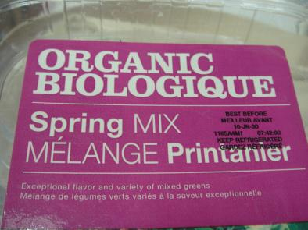
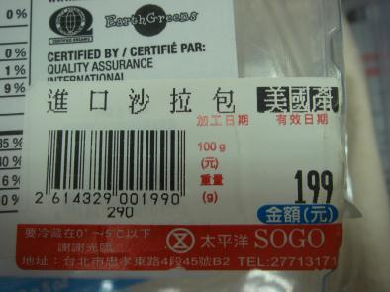
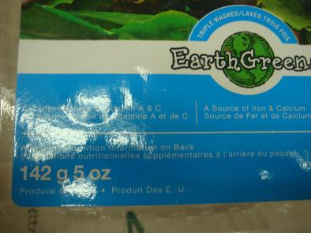
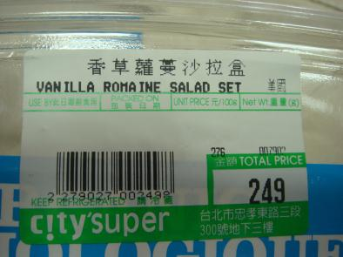

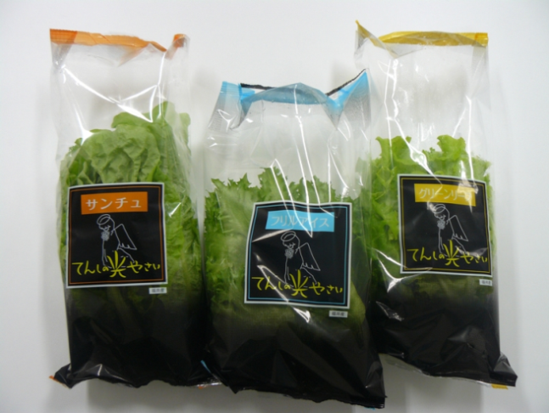
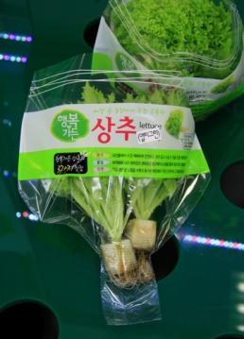
¥360 for 120 g (1.2 NT$/g)
¥198 for 60 g (1.32 NT$/g)
Ｒｅｔａｉｌ Ｐｒｉｃｅ ｉｎ ｓｕｐｅｒｍａｒｋｅｔｓ ｏｆ
Ｔａｉｗａｎ， Ｊａｐａｎ ａｎｄ Ｋｏｒｅａ
199~249 NT$ for 142 g (1.4~1.75 NT$/g)
70 NT$ for 50 g (1.4 NT$/g)

Slide 50
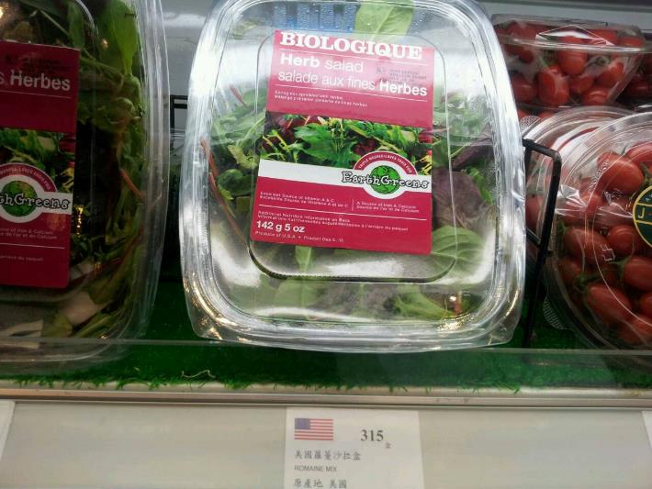
TAIPEI, TAIWAN
142 g 315 NT$

Slide 51
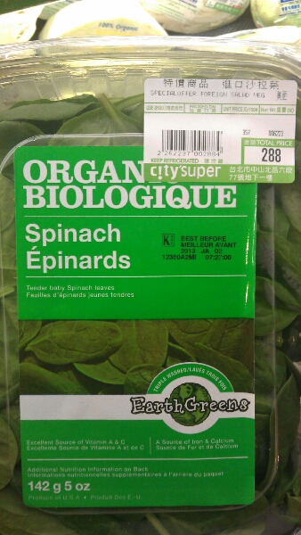
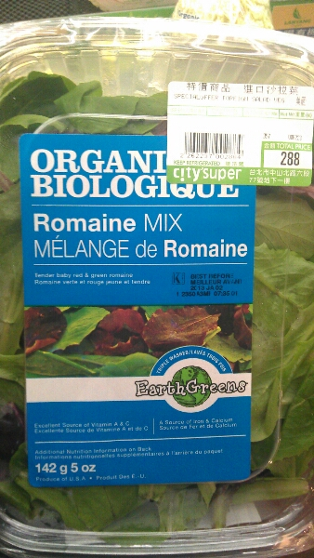
2011: 199 NT$/142 g
TAIPEI, TAIWAN
2012: 249 NT$/142 g
2013: 288 NT$/142 g
2014: 315 NT$/142 g
2015 ~ 2022: 288 NT$/142 g
1.4 NT$/g
1.75NT$/g
2 NT$/g

Slide 52




HK
Source | Sale | Product | Price HK$/100 g | NT$/100 g (1:4.167)
HK | 7/11 | 混裝苗菜 (16 HK$/30 g by iVeggie) | 53.3 | 222
US | Wellcome | 各種生菜與混裝苗菜 (盒裝) | 48.9 | 203
HK | FreshMart | 菠菜 (by UF) | 45 | 187
US | Wellcome | 各種生菜與混裝苗菜 (袋裝) | 44.9 | 187
US | CitySuper | 混裝苗菜 (62 HK$/142g) | 43.7 | 182
US | Wellcome | 各種生菜與混裝苗菜 | 34.9 | 141
HK | FreshMart | 奶油、皺葉生菜 (by UF) | 40 | 167
HK | FreshMart | 羅馬、橡葉、綠卷鬚生菜(by UF) | 30 | 125
US | Wellcome | 奶油萵苣 | 27.9 | 112
Aust. | FreshMart | 混裝苗菜 | 21 | 87
Aust. | Wellcome | 各式芽菜 (15.9/125 g) | 12.72 | 53
0.53~2.22 NT$/g

Slide 53
Percentages of cost components of a PFAL producing leaf lettuce in Japan (Ijichi, 2018)
Factor | Value
Fresh weight/head | 80 g
Unit price/head | 0.86 USD
Cost/head | 0.76 USD
Daily production | 1,000 kg
% revenue/sales | 11%
% sold | 95%
% sold to supermarket | 70%
% sold to biz use | 30%
Profit
11%
Others 11%
Others
11%
Seeds 2%
Logistics 5%
Consumables 6%
Electricity21%
Labor
21%
Electricity
18%
Costs for advertising, land etc. are excluded.
Copyright(C) 2018 JPFA All rights reserved.

Slide 54
Resource consumption and production cost/kg of leaf lettuce by components in selected PFALs in Japan (Kozai, 2018)
Resource element | Resource consumption | Cost (USD/kg)
Electricity | 7 – 8 kWh/kg | 0.85 - 1.2
Labor | 0.10 – 0.13 h/kg | 1.3 - 1.5
Cultivation area | 3 – 4 m²/kg | 1.1 - 1.4
Seeds, CO₂, water, fertilizer, substrate, plastic bags, etc. | --------- | 0.85 - 1.2
Production cost (USD/kg) |  | 4.1 - 5.3
Cost for sales promotion is excluded. One Euro = 130 Japanese yen as of 2017 (redrawn from Kozai, 2018). Labor cost = about 1200 yen/h for part-time workers, about 500,000 yen/month for regular employees as of 2017.
150,000 yen/month in Taiwan
785 yen/h in Taiwan

Slide 55
More index for performance evaluation
Area required per unit Yield
  How many sq. meters needed to produce 1 kg of vegetable?
Labor required per unit yield
  How many man-hour required to produce 1 kg of vegetable?
Resource required per unit yield
  How many degree of electricity required to …?
  How many Liter of water required to …?
  How many gram of fertilizer required to …?
3 ~ 4 m²/kg
0.10 – 0.13 h/kg
7 – 8 kWh/kg

Slide 56
Expected cost reduction and sales increase
Reduction in cost per kg of produce
Initial investment by 30%
Labor cost by 30%
Electricity cost by 30%
Increase in sales per m² of cultivation space
Annual productivity by 40%
Unit economic value by 15%
Relative CP = (1.40 x 1.15)/(0.70 x (0.26 + 0.21 + 0.18) + 0.35) = 1.61/0.805 = 2.00

Slide 57
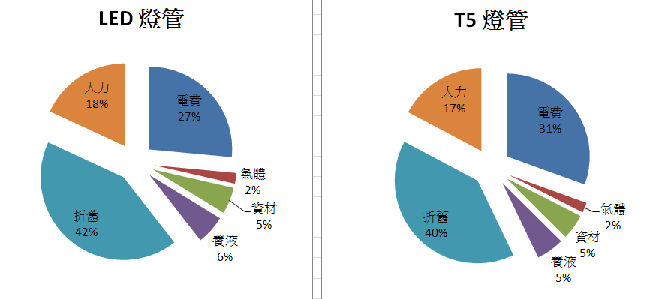
LED vs. T5
Cost: 20 NT$/plt
Elec.fee /plt
LED lamp
T5 fluorescent lamp
Labor
Elec.
Labor
Elec.
CO2
material
CO2
material
Depreciation
Nutrient
Depreciation
Nutrient

Slide 58
LED vs. T5
Cost: 20 NT$/plt
Light source
Elec.
Light source
Elec.
AC (COP=4)
Gas
AC (COP=4)
Gas
Fan
Materials
Fan
Materials
Air blower
Nutrients
Air blower
Nutrients
Water pump
Depreciation
Water pump
Depreciation
CO2
Labor
CO2
Labor
Seeds
Seeds
Sponge
Sponge
Nutrient
Nutrient
Water
Water
Dep.HW.10 yrs
Dep.HW.10 yrs
Dep.LED.5 yrs
Dep.T5.2 yrs
Labor
Labor
Sum
Sum
Harvest FW
Harvest FW
Cost per 100 g
NT$/100 g
Cost per 100 g
NT$/100 g

Slide 59
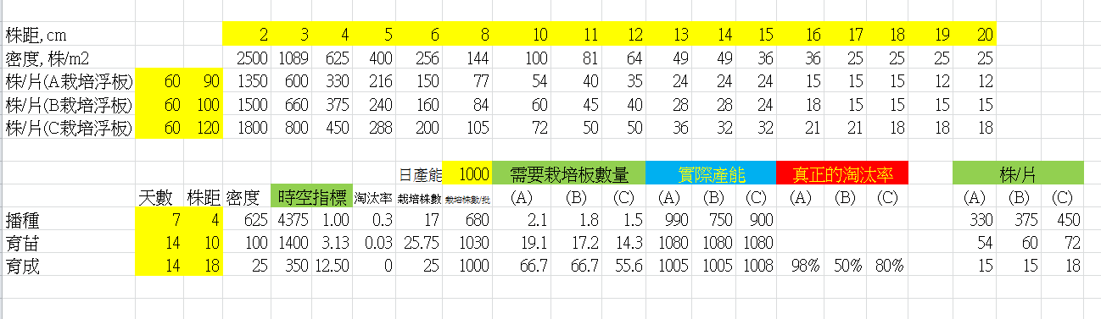
More details
Plant distance, cm
density, plts/m2
A
Plts/panel B
C
W L, cm
Production
Plts/panel
Target,plts
Panels needed
Stage
1
2
3
Days distance density
Elimination rate
tiers
ratio
Seeding bench
Seedling bench
Production bench

Slide 60
Amount of Investment at various size of the PFAL operation and per plant basis unit cost
Daily production
Plt/day
Investment
10k/plt
It takes 28~32k NT$/plt in Japan
Growth area needed
What is the proper size to start with?
How good can you sell your product
and at what price ?

Slide 61
Performance evaluation index
Pay back year & Internal Rate of Return (IRR)
density
Plts/m2
Net profit per plant
NT$/plt
Net Profit
NT$/m2/month
Cultural period
days
10k NT$/m2/year
10k NT$
/plt /m2
Investment
Payback Yr
IRR

Slide 62
Various Net Profit, in NT$/plt
10k NT$
/plt /m2
Net profit, in NT$/plant
Pay
back Yr
10k NT$
/plt /m2
Net profit, in NT$/plant
IRR

Slide 63
Estimation of Space required
Daily harvested
Plts/day
Days in Mature stage
days
Total num. of plts
No. of Tiers
layers
Plant distance
density
Plts/
Total production area
Total bench area
Other supporting area
Total area
ping

Slide 64
40 ft cargo container type PFAL
CONTAINER
ft
Length, m
Width, m
Area
Space utilization
tiers
Total prod. area
Cultural days
Area/plt
m2/plt
Total plts
plts
Plant distance, cm
density
Plt/m2
Daily harvested
Plts/day
Price of lamp, NT$
Length.lamp
cm
Lamp distance, cm
No. lamps
Cost of lamps
X 10k NT$
Ratio of Net profit
Net profit, 10k
Days with harvest
Total plts harvested/yr
FW, g/plt
Retail price, NT$/g
Revenue, 10k

Slide 65
Cost for a 40 ft. cargo container type PFAL
Cost
Cost/
HW besides light source
Light source
In Japan, 130~200 k NT$/m²

Slide 66
Annual depreciation per plant
Cost
Cost/
HW besides light source
Light source
Years
Annual depreciation
NT$/yr
NT$/m2/yr
NT$/plt/yr
HW besides light source
Light source
sum= 5.65

Slide 67
Fine tune on key parameters to reduce depreciation
Depreciation on HW besides light source
Depreciation on light source
Space
utilization
Plant
distance
Cultural days
No. of
tiers
Lamp
distance
NT$/plt/yr
NT$/plt/yr
6.37
sum= 5.65
2.01

Slide 68
Some thought regarding the Operating cost
Light period changed from 12 hr. to 24 hr.
  Operating cost will increased to 2 times (200%)?
  Wrong, only the elec. Cost on lighting will increase.
If the yield just increase 50%, thus, the revenue increase by 50%.
Does it worthwhile to make the change?
Why?

Slide 69
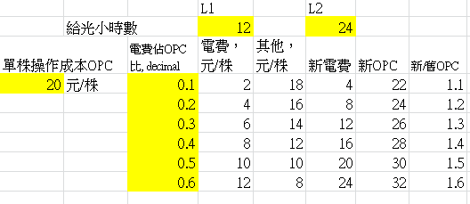
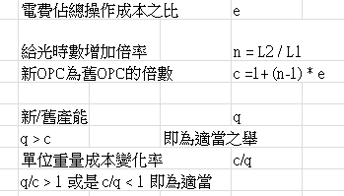
Hrs for light period
Ratio of elec.fee vs. OP cost
Elec.fee
NT$/plt
Other.fee
NT$/plt
Extra Elec.Fee
NEW
OP cost
NEW/OLD
OP cost
OP cost per plant
NT$/plt
Ratio of elec.fee vs. OP cost
NEW/OLD hrs of light period
NEW/OLD OP cost
NEW yield/OLD yield
The proper change
For those c/q < 1 (q > c)
are proper changes

Slide 70
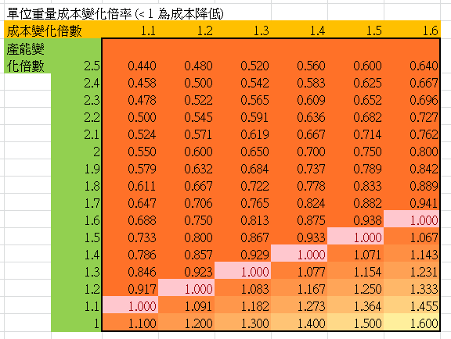
Ratio of OP cost
after vs. before
c
For those c/q < 1 (q > c) are proper changes
q
Ratio of yield after vs. before

Slide 71
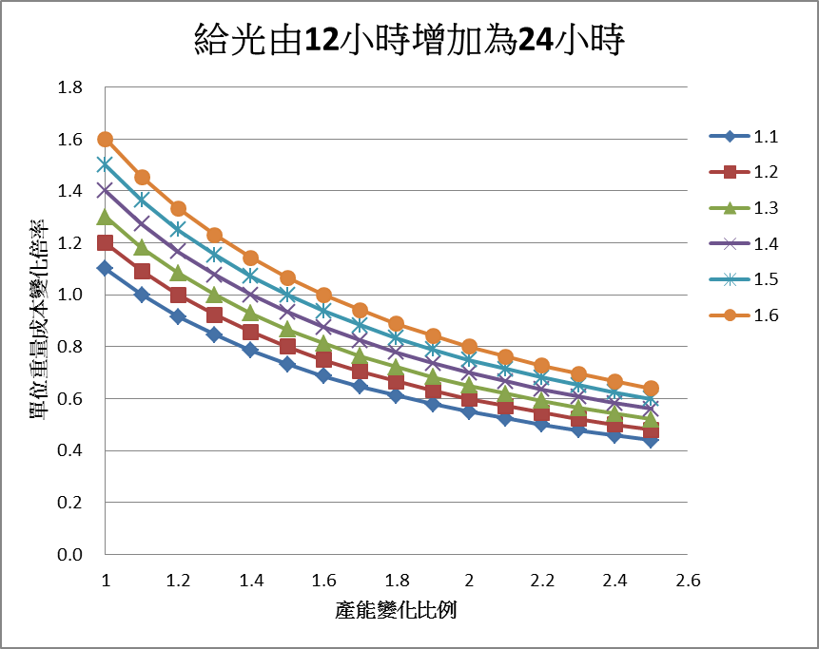
Light period increase from 12 hrs to 24 hrs
c
操作成本增加倍率
Ratio of OP cost
after vs. before
c/q
q
Ratio of yield after vs. before

Slide 72
Outline
Preface
All about COSTs
Growth parameters affect system design
Total Performance Evaluation (TPE)
How to…
1
2
3
4
5

Slide 73
Growth parameters influence system design
Relative growth rate
Moisture content → quality
Plant size → plant distance
Plant height → lamp2plant distance
Surface temperature of lamp → lamp2plant distance
Plant fresh weight → days of harvest, DLI, PPFD, Photoperiod

Slide 74
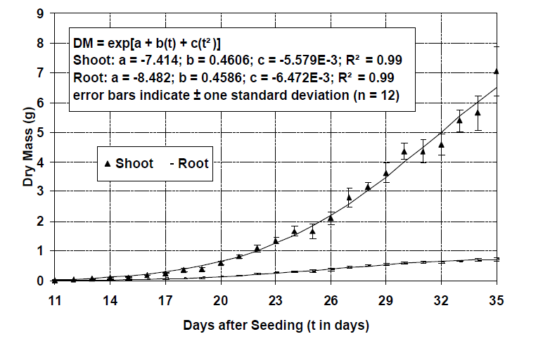
growth curves
A.J. Both, 2003

Slide 75
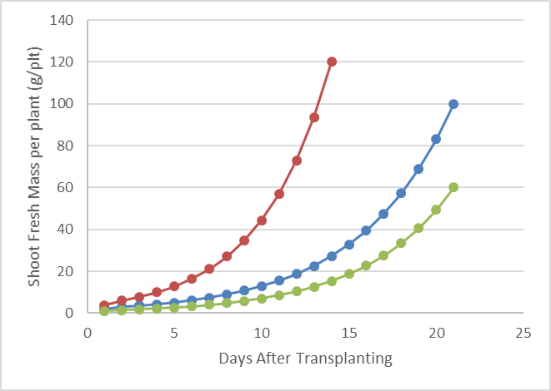
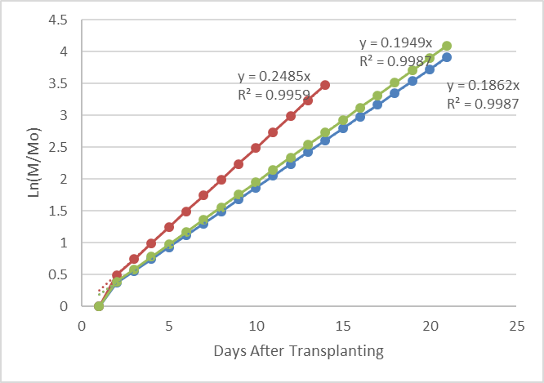
Relative growth rate
Harvest shoot fresh mass, in g/plant | M | 100 | 120 | 60
Shoot FM at transplanting | Mo | 2 | 3.69 | 1
 | Ln(M/Mo) | 3.912 | 3.482 | 4.094
Days from transplanting | t | 21 | 14 | 21
Growth rate | r=Ln(M/Mo) / t | 0.186 | 0.249 | 0.195
The slope is the growth rate (r)
21 days：18 batch/yr
14 days：26 batches, 8 more batches
yield increased by 44 %

Slide 76
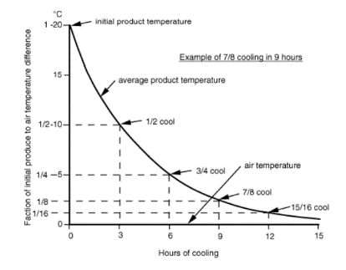

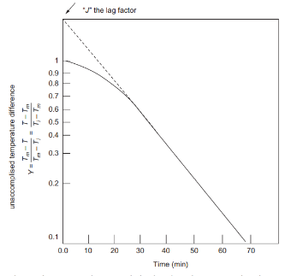

Similar pattern for cooling time estimation
Average product temperature during cooling follows a pattern similar to this Figure.
Product is usually finished cooling at 7/8 or 15/16 cool.
As shown in the Figure, this product takes 9 or 12 hours to reach 7/8 or 15/16 cool.
For hydrocooling, generally finished at ½ cool.
For forced air cooling, finished at 7/8 cool.
Tm: temperature of cooling medium
Ti: initial Temperature of the product
T: T of the product at a given time
C: cooling coefficient (the Slope)
θ: the time elapsed (the X)

Slide 77
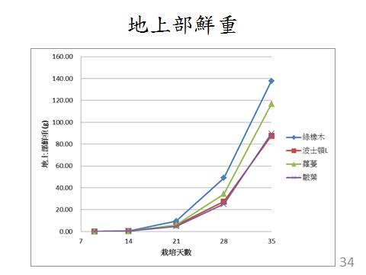
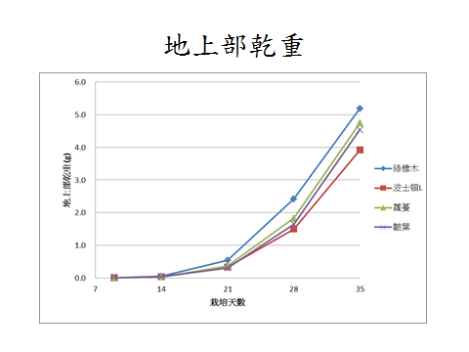
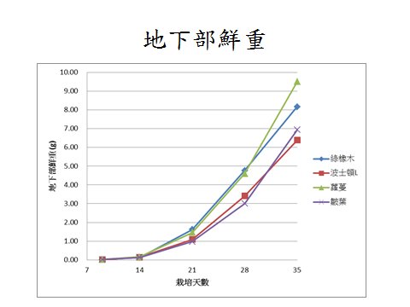
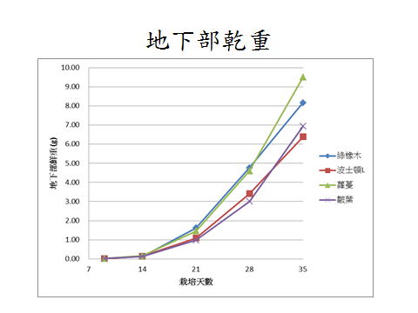
Shoot Fresh Weight
Shoot Dry Weight
Root Fresh Weight
Root Dry Weight

Slide 78
Roots
Plants need the root to grow well.
Growers do not want the root to grow too well.
Roots block the flow, influence the distribution of the nutrients to the roots.
Roots is normally discarded after harvest.
Size of roots should be minimized.

Slide 79

MC (moisture content)= 1 - DWR
DWR = Dry weight / Wet weight
= Dry weight / (Dry weight + Water)
Moisture content
Days After Transplanting

Slide 80

Plant height, cm
Days After Transplanting

Slide 81

Lamp2plant distance can be adjust automatically or manually
PPFD α 1/(lamp2plant distance)²

Slide 82

Leave length, cm
Romaine
Green Oak
Boston
Frilly
Days After Transplanting

Slide 83

Leave width, cm
Green Oak
Boston
Romaine
Frilly
Days After Transplanting

Slide 84
L x W x H (in cm)
 | Day 9 | Day 14 | Day 28 | Day 35
Green Oak | 1.7x1.3x0.8 | 6.5x4x3 | 22x21x10 | 27x25x22
Boston | 1.9x1.1x1.3 | 5x2.9x3 | 19x18x9 | 21x20x12
Romaine | 2x1x1.5 | 6.5x2.6x4 | 19x18x11 | 25x22x17
Frilly | 1.8x1.2x1 | 5x4x4 | 17x13x12 | 25x22x18

Slide 85
Plant distance vs. cropping density
Plant distance, cm
Cropping density, plt/m2
A
B
C
D
B = 10000 / A²
    example： 69 = 10000 / (12²)
C = 100 / sqrt(D)
  example： 2 = 100 / sqrt(2500)

Slide 86

Spacing: operation to change the plant distance
16 plt/tray = 44 plt/m²
144 plt/tray = 400 plt/m²

Slide 87


Adjustable spacing
Nursing
Seedling production
seeding
transplanting
harvest

Slide 88
Cultural stage: example
Seedling
Stage 1 (14 days)
Quality Adjustment
Stage 3 (7 days)
Mature
Stage 2 (14 days)
333 plants/m²
40 plants/m²
20 plants/m²

Slide 89
Cultural Stage: example
Seeding
Stage 1 (7 days)
Mature
Stage 3 (14 days)
Seedling
Stage 2 (14 days)
Density: 333 plants/m²
Density:40 plants/m²
Density: 20 plants/m²

Slide 90
Environmental settings: example
Parameters | Seedling | Mature | Quality Adjustment
 | Stage 1 | Stage 2 | Stage 3
PPFD (μmol/m²/s) | 230±30 | 270±30
Photo period (L/D ，hr) | 24/0 | 16/8
DLI (mol/m²/day) | 20 | 16
Temperature (L/D ，℃) | 22/20
RH度 (%) | 80 ~ 90
EC (mS/cm) | 1.2±0.1
pH | 5.8±0.1
CO2 (ppm) | 1200±100

Slide 91
Cultural stages can be varied due to different conditions
1 stage | 18.9 | 28 | 5 | 3.434 | 0.291 | 0.65
* RUI: Resource Utilization Index

Slide 92
Automatic spacing in 1 dimension

Slide 93


Slide 94



Slide 95


Slide 96


Slide 97


Slide 98

Automatic spacing in 2 dimensions
Upot

Slide 99
Air change per hour (ACH) air change per minute (ACM)
Simplified terms to describe the ventilation rate of a confined environment such as tissue culture vessel, naturally or forced ventilated greenhouse and plant factory with artificial lighting.

Slide 100
Steps to measure ACH
There are no plants and no workers in the PFAL/NVGH/TC. Vessel
Enrich CO₂ to the indoor to reach high concentration
NVGH: 3~4000 ppm
PFAL: 8000 ppm
Tissue Culture Vessel (T.C. vessel): 10000 ppm
This is C₀
Allow the CO₂ concentration to drop naturally.
Measuring the indoor CO₂ concentration in real time if possible
NVGH, PFAL, real time measurement is preferred
T.C. vessel: 30 min to 1 hour interval
Track the Time and the CO₂ concentration for at least 2 points (T₁, C₁; T₂,C₂)
with at least one hour interval

Slide 101

Measuring ACH
N=ln((C₁-C₀)/(C₂-C₀))/T
Where,
ln: natural log
T=T₂ - T₁ (h)
Time is the X axis,
Natural log of CO₂ concentration difference at Ti minus Co
N is the slope
T₁=2, T₂=3
C₀=360, C₁=10000, C₂=4000 (ppm)
→N=ln(9640/3640)/(3-2) = 0.97/h
T₁
T₂

Slide 102
net photosynthesis rate involving ACM or ACH

Slide 103
Net Photosynthesis rate (Pn) of PFAL/NVGH
Pn=k·n·v·(Co-Ci)
Where,
Pn: in ml/h·GH or PFAL
k: conversion factor from ml to g (1.96 x 10⁻⁶)
n: ACH
v: volume of the GH or PFAL
C_{o} , C_{i} : CO2 concentration of outdoor and indoor, ppm
Pn per unit dry mass = Pn/dry mass growth in GH PFAL
By adjusting light intensity, temperature and indoor CO2 to grow plants, after harvested, dry mass can be measured and
Pn per unit dry mass under various conditions can be derived.
Notes:
單位培養器皿的淨光合作用速率 Pv (ml/h·vessel) 可由下式求得 :
Pv=k·N·V·(C_{o}-C_{i})
這裡的 k 是將二氧化碳從容積 (ml) 轉換為質量 (g) 的變換係數 (1.96 x 10⁻⁶g)；
N 是換氣率；V 是培養器皿的容積。
C_{o} 和 C_{i} 的單位是 ppm，準確來說是 µmol/mol 。
此外 N 和 V 的積為培養器皿內單位時間的換氣量。
C_{o} 和 C_{i} 的差變小的同時 Pv 的計算誤差會變大。
單位培養植物、單位葉面積以及單位乾重的淨光合作用速率可將 Pv 分別除以單位培養器皿的培養植物數、葉面積以及乾重去求得，
此時可改變光強度、溫度或測量是內的二氧化碳濃度去進行各式各樣的 Pv 計算。

Slide 104

Net Pn of Forced Ventilated GH
Air at $\dot{V}$flow rate (in ml/h or m³/h) is forced to pass through the FVGH
Plant will consumed CO₂, thus CO₂ of incoming outdoor air (C_{o}) will be higher than CO₂ of the outgoing indoor air (C_{i})
When C_{i} maintain at steady state, the Pn of the indoor plants can be calculated as follows:
Pn=k·$\dot{V}$·(C_{o}-C_{i})
Notes:
還有另一種方法可以算 Pv，
就是把培養植物的一部分、全部，甚至是複數株培養植物放在測量室內，
然後把已知流量 v (ml/h) 的空氣以幫浦強制輸送。
測量室內培養植物的光合作用把二氧化碳消耗掉之後，出口空氣的二氧化碳濃度 C_{o} 就會比入口空氣的 C_{i} 還低。
當 C_{o} 的值幾乎不隨時間變動時，測量室內的培養植物 Pv 就能用以下式子算出 :
Pv=k·v·(C_{o}-C_{i})
這裡的 k 是前面提及的變換係數，v 是空氣流量 (ml/h)，由於 v 會和上式的 N, V 乘積相等，所以兩個式子是一樣的。若空氣流量比培養植物的大小、株數、光強度等等還大很多的話 (C_{o}-C_{i}) 的值就會變小，進而提高計算誤差。另外，測量室的容積要室過大就會導致 C_{o} 的安定所需時間變長。

Slide 105
mass balance involving ACH

Slide 106

Air Change per Hour of a NVGH
The setpoint should be at 400 vpm, if CO₂ enrichment is installed
EX1
Naturally Ventilated Greenhouse (NVGH)
ACH=3
ACH=20
400 vpm
Without CO₂ enrichment
Without CO₂ enrichment

Slide 107
Fundamentals of Plant Factory with Artificial Lighting (PFAL) By: Wei Fang, Ph.D., Professor, NTU_BME)
Greenhouse (GH) is 6 m height, floor area is 1 ha
Air flow rate (A) = ACH * 6 * 10^4 * 1.18 (m³/h * kg/m³) in kg air/ha/h
CO₂ difference (B) = (CO2.in-400) * 1.519 in mg CO₂/kg air
Rate of CO₂ going into the GH (C) = A*B /10^6, in mg CO₂/ha/h
ACH=20, CO₂.in=380 ppm, C=20*6*10^4*1.18*(380-400)*1.519/10^6 = -43.01
ACH= 3, CO₂.in=290 ppm, C= 3*6*10^4*1.18*(290-400)*1.519/10^6 = -35.49
ACH=20, CO₂.in=380 ppm, C=20*6*10^4*1.29*(380-400)*1.534/10^6 = -47.49
ACH= 3, CO₂.in=290 ppm, C= 3*6*10^4*1.29*(290-400)*1.534/10^6 = -39.18
Calculated values are different from values shown in the figures are mainly due to two constants used.
Assuming CO2 density 1.18, ppm to mg/kg is 1.519
Assuming CO2 density 1.18, ppm to mg/kg is 1.519
 | ACH | CO2.in | Value Shown in Fig. | Calculated Value CO2 going into GH
GH without CO2 enrichment | 20 | 380 ppm | 45 | 43.01 | 47.48
GH without CO2 enrichment | 3 | 290 | 40 | 35.49 | 39.18
Assuming CO₂ density 1.29, ppm to mg/kg is 1.534
Assuming CO₂ density 1.29, ppm to mg/kg is 1.534

Slide 108

In a CO₂ enriched NVGH
The ACH should be as small as possible
EX2
ACH=20, 73.3% of CO₂ is wasted
ACH=3, 69.4% of CO₂ is wasted
400 vpm
With CO₂ enrichment
With CO₂ enrichment

Slide 109
Greenhouse (GH) is 6 m height, floor area is 1 ha
Air flow rate (A) = ACH * 6 * 10^4 * 1.18 (m³/h * kg/m³) in kg air/ha/h
CO₂ difference (B) = (CO2.in-400) * 1.519 in mg CO₂/kg air
Rate of CO₂ going out of the GH (C) = A*B/10^6, in mg CO₂/ha/h
ACH=20, CO₂.in=450 ppm, C=20*6*10^4*1.18*(450-400)*1.519/10^6 = 107.54
ACH= 3, CO₂.in=750 ppm, C= 3*6*10^4*1.18*(750-400)*1.519/10^6 = 112.9
ACH=20, CO₂.in=450 ppm, C=20*6*10^4*1.29*(450-400)*1.534/10^6 = 118.7
ACH= 3, CO₂.in=750 ppm, C= 3*6*10^4*1.29*(750-400)*1.534/10^6 = 124.6
Calculated values are different from values shown in the figures are mainly due to two constants used.
Assuming CO2 density 1.18, ppm to mg/kg is 1.519
 | ACH | CO2.in | Value Shown in Fig. | Calculated Value CO2 going out of GH
GH With CO2 enrichment | 20 | 450 | 132 | 107.54 | 118.7
GH With CO2 enrichment | 3 | 750 | 125 | 112.9 | 124.6
Assuming CO₂ density 1.29, ppm to mg/kg is 1.534

Slide 110
EX3
A greenhouse has a volume of 3000 m³, ACH is 0.75. Indoor air T is 20 ºC, RH is 70 %, outdoor CO₂ is 345 ppm. Indoor CO₂ keep at 1000 ppm (1519 mg/kg) to promote plant growth. What is the loss rate of CO₂ ? Assuming 20 NT$ per kg CO₂, what is the loss per day? What if indoor CO₂ changes to 380 ppm?
Sol: T=20 ºC, RH=70 %, air density=1.18 kg/m³
m_{air} = 1.18 kg/m³ * 3000 * 0.75 /3600 = 0.7375 kg/s
m_{vo} = 0.7375 kg/s * 1.519 * (1000 – 345) mg/kg
= 733.8 mg/s = 2.64 kg/hr
Loss per day = 2.64 * 24 * 20 = 1267 NT$
Loss = 1267 * (380-345)/(1000-345) = 67.7 NT$

Slide 111
EX4
A PFAL has a volume of 3000 m³, ACH is 0.75. Indoor air T is 20 ºC, RH is 70 %, outdoor CO₂ is 345 ppm. Indoor CO₂ keep at 1000 ppm (1519 mg/kg) to promote plant growth. What is the loss rate of CO₂ ? Assuming 20 NT$ per kg CO₂, what is the loss per day? What if ACH changes to 0.01?
Sol: T=20 ºC, RH=70 %, air density=1.18 kg/m³
m_{air} = 1.18 kg/m³ * 3000 * 0.75 /3600 = 0.7375 kg/s
m_{vo} = 0.7375 kg/s * 1.519 * (1000 – 345) mg/kg
= 733.8 mg/s = 2.64 kg/hr
Loss per day = 2.64 * 24 * 20 = 1267 NT$
Loss = 1267 * 0.01/0.75 = 16.89 NT$

Slide 112
EX5
Carbon Dioxide produced By Animals
Rule of thumb: Every 24.6 kJ of total heat added to the environment by an animal will produced 1 L of CO₂. (1 L/s CO₂ = 24.6 kW)
CO₂ concentration outdoor is 345 ppm (parts per million, vpm),
345 x 1.519 = 524 mg of CO₂/kg of Air.
Given the flow rate of the animal house is 4.3 m³/s, the total amount of heat produced by the animals is 361.8 kW.
CO₂ produced (Vp) = 361.8 / 24.6 = 14.7 L/s = 0.0147 m³/s
V_{p} + V_{vi} = V_{vo}
0.0147 + [4.3 m³/s * 0.000345 ] = [4.3 m³/s * CO_{2indoor}]
CO_{2indoor} = 0.003764 = 3764 ppm

Slide 113

EX6
Mass balance of CO2 enrichment
mmolCO₂ h⁻¹
CO_{2outdoor}= 350 ppm = 686 mg/10^6 m3
CO2supply=0~1000 mg/h=0~22.72 mmolCO2/h
Volume=20~100 m3
Tindoor=25 C
ACH=0.1
CO_{2indoor} can be calculated
C_{leak} can be calculated
C_{supply} = C_{assimilated}+C_{leak}
m³
mgCO₂ h⁻¹
Your Homework to redraw this figure

Slide 114
Water /CO₂ utilization can be calculated based on mass balance and ACH.

Slide 115
Outline
Preface
All about COSTs
Growth parameters influence system design
Total Performance Evaluation (TPE)
How to…
1
2
3
4

Slide 116
Total Performance Evaluation (TPE) for PFAL design and operation
How to select the crop?
How to choose the most suitable lamps?
How to operate a PFAL to guarantee success?
Based on Quantitative index

Slide 117
The 1st Quantitative index
Photons vs. Energy consumption
QE ratio = PPFD x Area / energy consumed by the light source (in μmol/J)

Slide 118
How to choose the light source?
PPFD
a
Area
b
No. lamps
c
d
Power/lamp
QE ratio
a x b / (c x d)
Relative
QE ratio
= μmol/J
QE ratio: Quantum generated vs. Energy consumed by the light source

Slide 119
Two definitions on μmol/J
Light beam vs. its own energy
  E = h * C / λ
Light beam vs. Energy of the electricity input
It is termed ‘QE ratio’

Slide 120
Conversion factor
from energy to quantum and vise versa

Slide 121



E: energy h: Planck constant
C: speed of light λ: wavelength

Slide 122



This is another μmol/J
E = ${h C}/λ$
Energy of 1 μmol of photos
at various wavelength
Number of photons under
same amount of energy

Slide 123
Two definitions on μmol/J
Light beam vs. its own energy
  E = h * C / λ
Light beam vs. Energy of the electricity input
It is termed ‘QE ratio’
It is an index for lighting efficacy
An index for the arrangement, installation and selection
of light source

Slide 124

Lighting efficacy, in μmol/J, is the index to evaluate the selection and installation of lamps on top of a cultural bed
n
p
L
A
Distance (cm)
μmol/J
Cultural bed
QE ratio = L*A/(n*P)
  PPFD (in μmol m⁻² s⁻¹) need to measured at a fixed distance for comparison (say FL: 20 cm, LED: 10 cm)

Slide 125



QE ratio
Too far away from light to plant

Slide 126



T5 FLs at 10 cm interval
T5 FLs at 20 cm interval w/ reflector

Slide 127
Reflectors make a great difference in improving the QE ratio
Arrangement | QE ratio μmol/J
 | 1.0
 | 1.2
 | 1.3
 | 1.6
 | 1.8

Slide 128




Cold Cathode Fluorescent Lamp
Efficiency of light source is too low
With reflector
PPF increase from 113 to 229 μmol/m2/s

Slide 129
Impact of reflectors on QE ratio
LED | reflector | Distance below lamps (cm) | Avg. PPFD ( μmol m⁻² s⁻¹ ) | Area ( m² ) | PPFD x Area ( μmol s⁻¹ ) | Power ( W ) | QE ratio ( μmol J⁻¹ )
9 CW LED | no | 10 | 199.6 ± 43.8 | 2.16 | 431.1 | 189 | 2.3
9 CW LED | yes | 10 | 273.9 ± 79.8 | 2.16 | 589.7 | 189 | 3.1
w/o reflector
w/ reflector

Slide 130
0º
20º
Impact of rotating angle of 2 lamps
at the edge of the cultural bed on Le
0º
20º
40º
Totally 6 lamps, turn on only 2 lamps at both edges.
Adjust the orientation of these 2 by 0, 20, 40 degree toward cultural bed.
Turn 40 degree toward cultural bed is the best.
40º

Slide 131
0º
Avg. PPFD
313
326 →
334
20º
0º
20º
→
120
40º
100
Turn on all 6 lamps
Adjust 2 lamps at the edge at 0, 20, 40 degree toward cultural bed.
80
60
40
20
40 度
40º
0
0
20
40
60
80
100
120
140
160
180

Slide 132
QE ratioof various Lamps installed per cultural bed
Corp. and tube length of CW LEDs | Distance under lamp (cm) | PPFD (μmol m⁻² s⁻¹) | Area (m²) | PPFD x Area (μmol/s) | Power per tube (W/tube) | No. tubes | Total Power (W) | QE ratio μmol/J
SA_CW_1.8 m (0 deg.) | 10 | 313.6 ± 69.8 | 2.16 | 677.5 | 28.83 | 6 | 172.97 | 3.9
SA_CW_1.8 m (20 deg.) | 10 | 326.2 ± 77.4 | 2.16 | 704.6 | 28.83 | 6 | 172.97 | 4.1
SA_CW_1.8 m (40 deg.) | 10 | 334.9 ± 86.6 | 2.16 | 723.4 | 28.83 | 6 | 172.97 | 4.2
AR_CW_1.2 m (0 deg.) | 10 | 281.6 ± 59.4 | 2.16 | 608.4 | 21.67 | 9 | 195.00 | 3.1
improve 18.9 %
Save 11.8 %
improve 35.5 %
*Area of cultural bed：1.2 m x 1.8 m

Slide 133
Lighting efficiency (QE Ratio)
Comp_Spec of Light sources | Reflectors on top | No. of tubes or panels | PPF* μmol m⁻² s⁻¹ | PPF x Area ( μmol s⁻¹ ) | Power consumption, W | QE ratio μmol J⁻¹
S_CW1.8 | Y | 6 Tubes | 334.9 ± 86.6 | 723.4 | 172.97 | 4.2
T_V | Y | 9 tubes | 281.6 ± 59.4 | 608.4 | 195 | 3.1
H_CW | Y | 9 tubes | 273.9 ± 79.8 | 73.9 | 212 | 3.1
T_A | Y | 9 tubes | 225.8 ± 49.1 | 487.8 | 189 | 2.6
E_CW | Y | 9 tubes | 263.8 ± 64.2 | 569.8 | 228 | 2.5
T_A | no need | 12 panels | 411.5 ± 103.2 | 888.9 | 432 | 2.1
T_N | Y | 9 tubes | 186.7 ± 39.3 | 403.2 | 196 | 2.1
E_WW | Y | 9 tubes | 210.8 ± 51.0 | 455.3 | 229 | 2.0
T_N | no need | 12 panels | 378.4 ± 95.4 | 809.6 | 428 | 1.9
T_M | Y | 9 tubes | 168.0 ± 39.1 | 326.9 | 193 | 1.9
T_M | no need | 12 panels | 387.3 ± 99.4 | 836.5 | 442 | 1.9
T_Y | Y | 9 tubes | 168.3 ± 34.7 | 363.5 | 188 | 1.9
S_R | no need | 12 panels | 291.0 ± 71.3 | 628.6 | 334 | 1.9
T5FL_CW | Y | 9 tubes | 250.0 ± 57.5 | 540 | 283 | 1.9
* Measured at 10 cm distance under light except the T5FL treatment (at 20 cm distance)
** Area of culture Bed on bench per layer = 1.8 m x 1.2 m = 2.16 m²

Slide 134
Quantitative measures
Knowing µmol / J (QE ratio) is not enough
We defined two new terms
    PY (photon yield): gFW/mole of photons provided from seeding (sowing) to harvest
    EY (energy yield): gFW/degree of energy consumed from seeding (sowing) to harvest

Slide 135








4 types of LED panel, 2 types of lettuce

Slide 136
Which crop make better use of light?
 | Lettuce 1 |  | Lettuce 2 |  | Overall QE ratio
 | PY g/mole | EY g/deg. | PY g/mole | EY g/deg. | mole/deg. | ratio
LED1 | 32.2 | 44.2 | 18.5 | 25.3 | 1.4 | 1
LED2 | 31.1 | 101.2 | 22.0 | 71.6 | 3.3 | 2.35
LED3 | 34.4 | 67.0 | 20.7 | 40.4 | 1.9 | 1.35
LED4 | 32.0 | 74.8 | 20.1 | 46.9 | 2.3 | 1.64
Avg. | 32 | 72 | 20 | 46
Lettuce 1 generate 60% more biomass under same amount of light. (g/mol)
Lettuce 1 generate 56% more biomass under same power consumption. (g/deg)

Slide 137
Which LED is the best for the crop?
 | Lettuce 1 |  | Lettuce 2 |  | Overall QE ratio
 | PY g/mole | EY g/deg. | PY g/mole | EY g/deg. | mole/deg. | ratio
LED1 | 32.2 | 44.2 | 18.5 | 25.3 | 1.4 | 1
LED2 | 31.1 | 101.2 | 22.0 | 71.6 | 3.3 | 2.35
LED3 | 34.4 | 67.0 | 20.7 | 40.4 | 1.9 | 1.35
LED4 | 32.0 | 74.8 | 20.1 | 46.9 | 2.3 | 1.64
Avg. | 32 | 72 | 20 | 46
biomass production per power consumption: LED2 > LED4 > LED3 > LED1 for both lettuce (can be seen under DY and mol/deg)

Slide 138
Which crop to select?
Stages
1
2
3
E = A*B*C*D /1000
G = E / F
1 kW.hr = 1 Degree
g/plant
deg/plt
g/deg
35 days
Romaine
Green Oak
Frilly

Slide 139
Strong light condition (z1)
Stages
Plt/m2
PPFD
mol/plt
1
2
3
D = B*C*3.6 /1000
F = D*E / A
PPFD, in μmol/m²/s
DLI, in mol/m²/day

Slide 140
The 2nd Quantitative index
PY = FW/TLI (in g/mol)
  Photon Yield: One mole of photon can produce how many grams of plants
  FW: Fresh weight per plant, in g/plant
  TLI: overall Total Light Integral per plant, in mol/plant

Slide 141

TLI: overall total light integral
s | A | B | C | TLI(s)=B*C/A
 | plt/m² | DLI | days | mol/plt
1 | 333 | 20 | 14 | 0.84
2 | 40 | 16 | 14 | 5.6
3 | 20 | 17 | 7 | 5.95
 |  |  | Sum | 12.39
DLI = PPFD x hrs x 3.6 / 1000
PPFD in μmol/m²/s
Hrs: light period per day
DLI in mol/m²/day
TLI : overall Total Light Integral per plant
$$TLI=\sum_{s=1}^{n}{TLI(s)}$$

Slide 142
The 3rd quantitative index
Energy Yield: EY (g/degree)
g/plant
g/mol
g/deg
mol/deg
Romaine
Green Oak
Frilly
D = C / B, values should be the same among treatments
PY
EY

Slide 143
Low light condition (z2)
Stages
Plt/m2
PPFD
mol/plt
1
2
3
g/plant
g/deg
mol/deg
Romaine
Green Oak
Frilly

Slide 144
z1 vs. z2
In low light condition (z2)
  g/mol (PY) is higher
In strong light condition (z1)
  g/plt is higher
  g/degree (EY) is higher
  mol/degree is higher

Slide 145
Code
N??_E??_F??_D??
N??_E??_L??_??_D??
N ? | E ? | F ? L ??_?? | D ?
Type of nutrient solution (NS) formula | Concentration of NS by EC in mS/cm, or dS/m. | Type of artificial light F: Fluorescent lamp L: LED And PPFD value in μmol/m²/s | DLI in mol/m²/day
N1, N2 | E1.2 E0.1, E0.6, E1.2 | F 230, 270 L 9R 100 L 8R1B 100 L 4CW4R1B 100 L 9CW 100 L RB 270 | D 16 D 20, 16, 9 D 15, 16, 17, 18

Slide 146
DLI in mol/m²/day
DLI =PPFD x Light period (hr/day) x 3.6 / 1000
PPFD | 230 μmol/m²/s | 270
Light period | 24 hrs | 16 hrs
DLI | 230 x 24 x 3.6 / 1000 = 19.87 | 270 x 16 x 3.6 / 1000 = 15.55

Slide 147
1. Variation on Nutrient
treatment | Stage 1 (1~14 days) | Stage 2 (15~28 days) | Stage 3 (29~35 days)
1 | N1_E1.2_F230_D20 | N1_E1.2_F270_D16 | N1_E1.2_F270_D16
2 |  | Same with above | N1_E0.6_F270_D16
3 |  | Same with above | N2_E1.2_F270_D16
4 |  | Same with above | N3_E0.1_F270_D16
5 |  | Same with above | N3_E0.1_F270_D16*
6 |  | N2_E1.2_F270_D16 | N2_E1.2_F270_D16
7 |  | Same with above | N2_E0.6_F270_D16
N1：迦南農場配方，N2：花寶1號，N3：清水
E：EC, in mS/cm
F：Color Temperature 3000 K, Fluorescent lamp, in μmol/m²/s
D：DLI in mol/m²/day
*：treated for only 3 days prior to harvest (DAS 33~35, others treated for 7 days

Slide 148
2. Variation on Light quality
treatments | Stage 1 (1~14 days) | Stage 2 (15~28 days) | Stage 3 (29~35 days)
8 | N1_E1.2_F230_D20 | N1_E1.2_F270_D16 | N1_E1.2_L9R_100_D9
9 | Same with above | Same with above | N1_E1.2_L8R1B_100_D9
10 | Same with above | Same with above | N1_E1.2_L4CW4R1B_100_D9
11 | Same with above | Same with above | N1_E1.2_L9CW_100_D9
E：EC, in mS/cm
L：LED, 9R: totally red, 9 red chips in one unit of light source
8R1B: 8 red chips 1 blue chips in one unit,
4CW4R1B: 4 CW chips, 4 red chips and 1 blue chip per unit,
9CW: 9 CW chips per unit of light source, all in μmol/m²/s
D：DLI in mol/m²/day

Slide 149
3. Variation on DLI＠stage 3 only
treatments | Stage 1 (1~14 days) | Stage 2 (15~28 days) | Stage 3 (29~35 days)
12 | N1_E1.2_F230_D20 | N1_E1.2_F270_D16 | N1_E1.2_F270_D15
13 | Same with above | Same with above | N1_E1.2_F270_D16
14 | Same with above | Same with above | N1_E1.2_F270_D17
15 | Same with above | Same with above | N1_E1.2_F270_D18
Fluorescent lamp: three wavelength T5, Color temperature 3OOO K (Wellpower, Taiwan)

Slide 150
4. Variation on nutrient under fixed DLI
treatments | Stage 1 (1~14 days) | Stage 2 (15~28 days) | Stage 3 (29~35 days)
16 | N1_E1.2_F230_D20 | N1_E1.2_F270_D16 | N1_E0.6_F270_D17
17 |  | Same with above | N2_E1.2_F270_D17
18 |  | N2_E1.2_F270_D16 | Same with above
19 |  | Same with above | N2_E0.6_F270_D17

Slide 151
5. Using RB LED under fixed DLI
treatments | Stage 1 (1~14 days) | Stage 2 (15~28 days) | Stage 3 (29~35 days)
20 | N1_E1.2_F230_D20 | N1_E1.2_F270_D16 | N1_E0.6_LRB_270_D17
21 | Same with above | Same with above | N1_E0.2_LRB_270_D17

Slide 152

ＰY
Treat-ments | Stage 1 (Day 1~14) | Stage 2 (Day 15~28) | Stage 3 (Day 29~35) | Total LI | Shoot FW | ＰY
1 | N1_E1.2_F230_D20 | N1_E1.2_F270_D16 | N1_E1.2_F270_D16 | 12.04 | 138.86 | 11.52
2 |  |  | N1_E0.6_F270_D16 |  | 106.50
3 |  |  | N2_E1.2_F270_D16 |  | 125.68
4 |  |  | N3_E0.1_F270_D16 |  | 79.89 | 6.63
5 |  |  | N3_E0.1_F270_D16* |  | 109.55
6 |  | N2_E1.2_F270_D16 | N2_E1.2_F270_D16 |  | 91.89
7 |  |  | N2_E0.6_F270_D16 |  | 85.16

Slide 153
Ｃｏｍｐａｒｉｓｏｎ ｏｎ ｈｉｇｈｅｓｔ ａｎｄ ｌｏｗｅｓｔ ＰＹ
Treat-ments | Stage 1 (Day 1~14) | Stage 2 (Day 15~28) | Stage 3 (Day 29~35) | TLI/plt | Shoot FW/plt | PY
16 | N1_E1.2_F230_D20 | N1_E1.2_F270_D16 | N1_E0.6_F270_D17 | 12.39 | 136.5 | 11.01
17 |  |  | N2_E1.2_F270_D17 |  | 125.2
18 |  | N2_E1.2_F270_D16 |  |  | 112.4
19 |  |  | N2_E0.6_F270_D17 |  | 104.6
20 | N1_E1.2_F230_D20 | N1_E1.2_F270_D16 | N1_E0.6_LRB_270_D17 | 12.39 | 159.5 | 12.87
21 |  |  | N1_E0.2_LRB_270_D17 |  | 104.2
Treatment no. | Shoot FW/plt, g/plt | TLI/plt, mol/plt | PY, g/mol
The best: no. 20 | 159.5 | 12.39 | 12.87
The worst: no. 4 | 79.89 | 12.04 | 6.63
The best vs. the worst:
(12.87-6.63)/6.63 x 100 = 94.1 %
153

Slide 154
7 days prior to harvest, change from FL to LED
FL (CT=3000 K) vs. RB LED (R:B=9:1)
DAS =35 days
FL vs. RB LED (7 days prior to harvest)
FW 16.9 % difference
(RB LED is better due to spectral difference)
treatments | FW g/plt | TLI mol/plt | ＰY g/mol
20. FL+FL+LED | 159.5 | 12.39 | 12.87
16. FL+FL+FL | 136.5 | 12.39 | 11.01
ＰY= FW/TLI (in g/mol)

Slide 155
7 days prior to harvest, change from FL to LED
FL (CT=3000 K) vs. RB LED (R:B=9:1)
Nitrate 8 % difference
(RB LED is better due to more RED)
treatment | g/plt | Nitrate ppm
20. FL+FL+LED | 159 (better) | 2291 (better)
16. FL+FL+FL | 136 | 2475

Slide 156

    Proper prior planning prevents poor performance
Q & A
Line and Wechat ID: weifang0257

